Slide 1
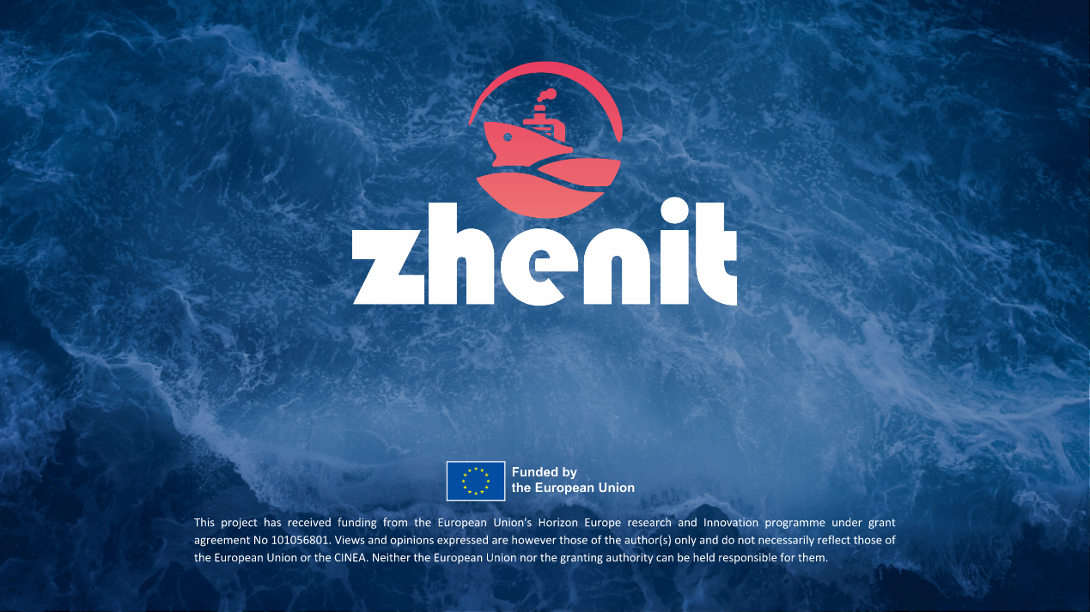

1st Workshop “Navigating Towards Zero-Emission Shipping: The IMO Decarbonization Goals and ZHENIT Project” – October 18th 2024
MARINE ENVIRONMENT PROTECTION OVERVIEW OF KEY INDUSTRY TARGETS
Alessandro Maccari – RINA Services

Slide 2




Current Regulatory Framework
International Conventions (SOLAS, MARPOL
Load Line…)
Classification Rules Unified Requirements Unified Interpretations
Recommendations…
ICS, BIMCO,
INTERTANKO,
INTERCARGO,
OCIMF, TSCF …
Industry Standards, Recommended Guidelines

Slide 3
European Institutions and Regulations
EU Council legal instruments (EU Directives and Regulations on safety, mostly implementing IMO regulations)
EU Parliament and Council legal instruments (“safety packages”)
Regulations and policies related to the safety of passenger ships
Recommendations
...

Slide 4
National Rules and Laws
to be complied with, as issued by ship Flag Administration
Safety national regulations
Load Line national regulations
National tonnage regulations
National MARPOL regulations
National crew health and habitability
…

Slide 5

IMO establishes Conventions to
grant safety of life at sea
protect the marine environment, prevent pollution
“Safe, secure and efficient shipping on clean oceans”

Slide 6
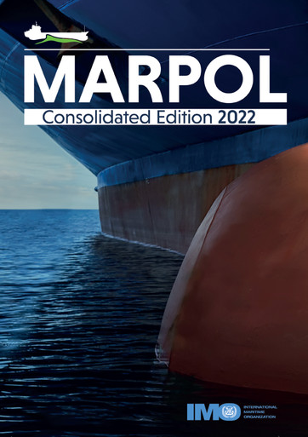
International Convention for the Prevention of Pollution from Ships (MARPOL)
Adoption: 1973 (Convention), 1978 (1978 Protocol), 1997 (Annex VI) - Entry into force: 2 Oct.1983 MARPOL is updated by amendments through the years

Slide 7
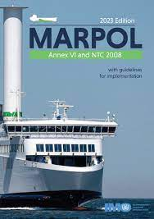
MARPOL Annex VI
Annex VI Prevention of Air Pollution from Ships
Sets limits on sulphur oxide and nitrogen oxide emissions from ships.
Prohibits deliberate emissions of ozone depleting substances.
Designates emission control areas with more stringent standards.
Covers mandatory technical and operational energy efficiency measures aimed at reducing greenhouse gas emissions from ships.
MARPOL Annex VI has 100+ Contracting States, representing 96.65% of world merchant shipping by tonnage.

Slide 8
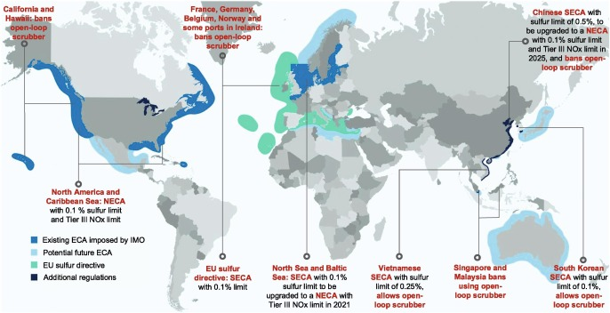
MARPOL - Emission Control Areas (ECA)

Slide 9
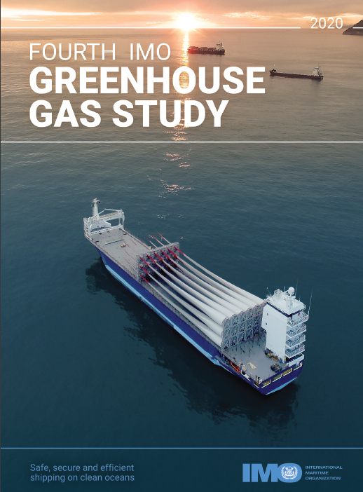
Greenhouse Gas (GHG) Emissions
https://www.imo.org/en/OurWork/Environment/Pages/Fourth-IMO-Greenhouse-Gas-Study-2020.aspx
The shipping industry compared to land-based emissions is the 6th largest emitter of CO₂
Total shipping emitted 1056 million tonnes of CO₂ in 2018 (2.89% of total global anthropogenic CO₂ emissions).
Without action, global shipping GHG emissions might reach 17% by 2050
Over 90% of world goods are transported by ships

Slide 10
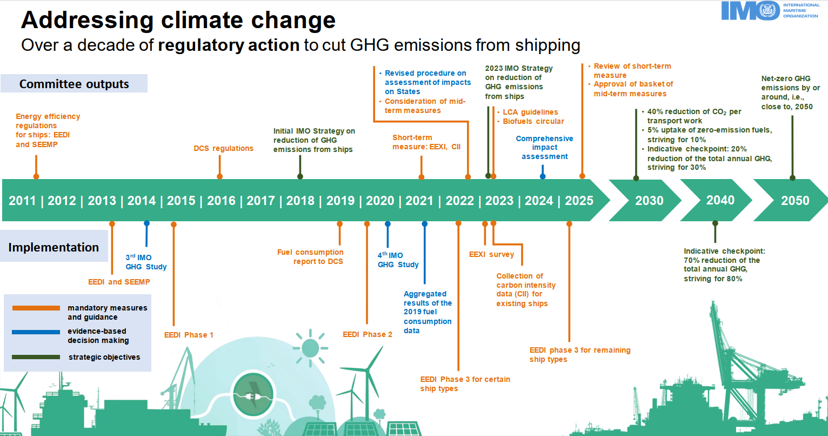

Slide 11
?
Revised 2023 GHG Strategy - MEPC 80
In July 2023 IMO GHG Strategy was revised: Res. MEPC.377(80) includes new levels of ambition and enhanced targets:
uptake of zero or near-zero GHG emission technologies, fuels and/or energy sources to represent at least 5%, striving for 10%, of energy used by international shipping by 2030;
peak GHG emissions from international shipping as soon as possible and to reach net-zero GHG emissions by or around (i.e., close) to 2050, considering different national circumstances, with the following checkpoints:
  reduction of the total annual GHG emissions from international shipping by at least 20% striving for 30% by 2030, compared to 2008; and
  reduction of the total annual GHG emissions from international shipping by at least 70% striving for 80% by 2040, compared to 2008.

Slide 12
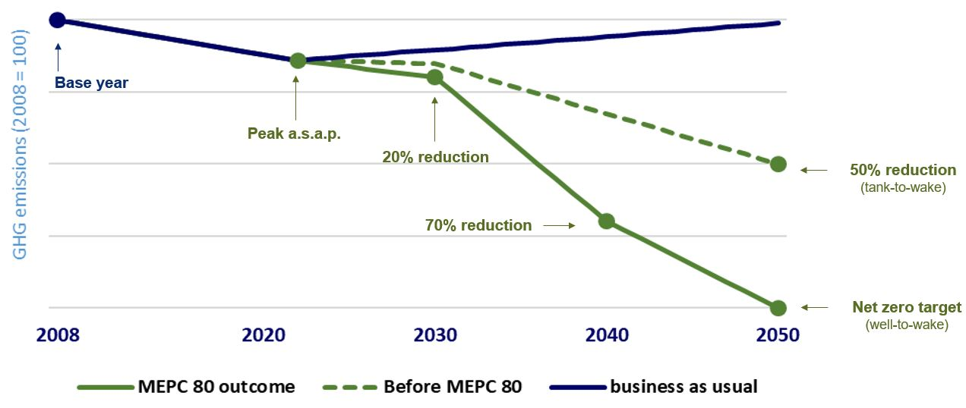
Strengthened IMO strategy on GHG Emissions

Slide 13
2023 – Revised IMO Strategy on Reduction of GHG Emissions from Ships
Targets achievable with current technology ?
Shipowners:
difficult short-term decisions with long-term implications, requiring practical approach for future-proofing assets.

Slide 14
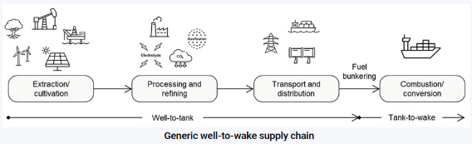

?
Life Cycle Assessment (LCA) Guidelines
IMO MEPC 80
LCA Guidelines - IMO Res. MEPC.376(80) - provide the methodology and the default factors to calculate the Well-to-Tank (WtT), Tank-to Wake (TtW), and Well-to-Wake (WtW) GHG intensity for all fuels and other energy carriers (e.g. electricity) used on-board, covering carbon dioxide (CO2), methane (CH4), and nitrous oxide (N2O) emissions.
GHG emissions are calculated as CO2- equivalent (CO2eq), using the Global Warming Potential over a 100-year time horizon (GWP100) to convert emissions of other gases than CO2.
LCA Guidelines address and specify sustainability themes/aspects for marine fuels, defining a Fuel Lifecycle Label (FLL), which carries information about fuel type, feedstock (feedstock type and feedstock nature/carbon source), conversion/production process (process type and energy used in the process), GHG emission factors, information on fuel blends and sustainability themes/aspects.

Slide 15
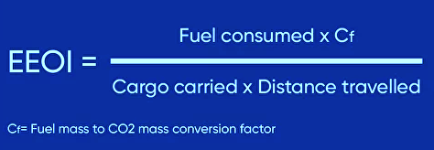
IMO Greenhouse Gas (GHG) Emissions
MARPOL Annex VI chapter 4 (1/1/2013, ships >400GT) defines a package of mandatory measures to reduce GHG emissions Regulations on energy efficiency for ships, introducing:
Energy Efficiency Design Index (EEDI), mandatory, performance-based for different ship type / size, the reference level is tightened incrementally every 5 years, requires that the amount of CO2 emitted by a vessel per tonne-mile of work be set using a formula based on the technical design parameters for a given ship. Designers are free to choose the technologies.
Ship Energy Efficiency Management Plan (SEEMP) operational measure for all ships, establishing a mechanism for operators to improve the energy efficiency of a ship (weather routing, trim / draught optimization, speed optimization, just-in-time arrival in port…) in a cost-effective manner. The SEEMP urges the ship owner and operator to consider new technologies and practices to optimize operational performance of a ship over time, using recognized monitoring tools (EEOI)

Slide 16
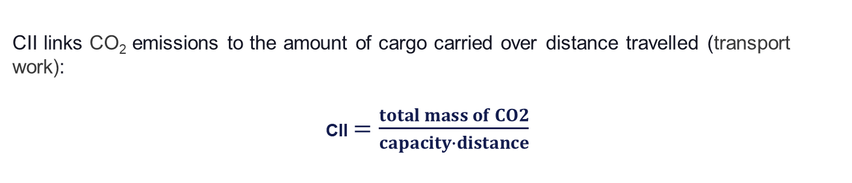
Greenhouse Gas (GHG) Emissions
IMO adopted further short-term measures aimed at cutting the carbon intensity of all ships, in line with the GHG emissions strategy.
All ships – including those already in operation, have to calculate their Energy Efficiency Existing Ship Index (EEXI)
Ships over 5,000 GT have to establish their annual operational carbon intensity indicator (CII) and CII rating, to be calculated at the end of each calendar year. Ships will get a rating of their energy efficiency - A, B, C, D, E - where A is the best.
CII links CO₂ emissions to the amount of cargo carried over distance travelled (transport work):
CII $=\frac{total mass of CO2}{capacity∙distance}$

Slide 18
Emissions from ships – IMO and EU
In parallel to IMO, the EU objective of climate neutrality by 2050 will also require innovation in shipping, including the supply and use of sustainable climate neutral marine fuels as well as the associated port storage and bunkering infrastructures.
In Europe, ships in short sea shipping have generally an age of 30+ years and the average age of inland ships is 40+ years → enormous task of implementing urgent action
[https://cordis.europa.eu/project/id/285405,https://www.forschungsinformationssystem.de/servlet/is/123471/]

Slide 19



EU Strategy – EU Regulatory Framework
2030
EU reduction of GHG emission by at least 55 % compared to 1990 levels by 2030
2050
2019
EU carbon neutrality (90% reduction of emission due to transport)
Presentation of EU Green Deal
2023
2040
Review of Climate Law
Possible new target set by the EC
TIMELINE
TIMELINE
1 Jan. 2024
1 Jan. 2026
1 Jan. 2027
MRV C₂O, CH₄, N₂O
ETS ships ≥ 5.000GT
(EUA 40% of emissions)
ETS ships ≥ 5.000GT
(EUA 100% of emissions) Commission Report to decide whether to lower the threshold to 400GT
ETS for offshore ships ≥ 5.000GT
1 Jan. 2025
MRV GC 400≤ GT≤5.000
Offshore ships ≥ 400GT
ETS ships ≥ 5.000GT (EUA 70% of emissions)
FuelEU ships ≥ 5.000GT

Slide 20
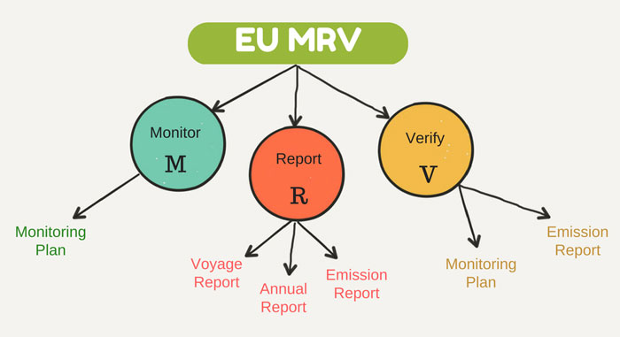
EU MRV Regulation
EU Regulation (EU 2015/757) does not define the max. level of CO2 emission allowed.
It focuses:
Monitoring
Reporting
Verification
SCOPE: measure and compare CO2 emission from ships

Slide 21
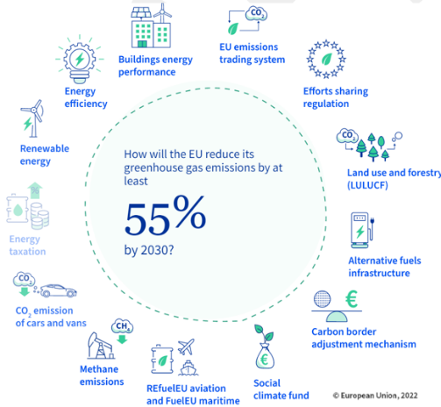
EU Strategy - Fit for 55 Package

Slide 22
Fit for 55 Package – FuelEU Maritime Regulation
Review of ETS Directive
  Application
  Ships above 5.000 GT – irrespective of the flags – in respect of:
      100% of the energy used within EU/EEA ports and from voyages between EU/EEA ports
      50% of the energy from voyages to or from EU/EEA ports, departing from or arriving at non-EU/EEA ports and from voyages to/from EU outermost regions
      Some derogations until 2029 or 2034 on specific routes or for ships sailing in ice conditions
  Emissions to be counted
      CO2 from 1st January 2024
      Methane (CH4) and nitrous oxide (N2O) from 1st January 2026

Slide 23
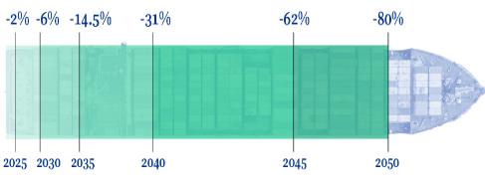
Fit for 55 Package – FuelEU Maritime Regulation
  Calculation of yearly average GHG intensity of the energy used on-board
  The yearly average GHG intensity of the energy used on-board by a ship shall not exceed the reference value, which is reduced by an increasing % from 2% in 2025 up to 80% in 2050
  Flexibility mechanism: Possibility of banking and borrowing surplus and small deficits between reporting periods
  Voluntary pooling of compliance between two or more ships
  Financial penalties for non-compliance
  Monitoring and reporting is based on MRV approach

Slide 24



Fit for 55 Package – FuelEU Maritime Regulation
Requirements and penalties
  From 1° January 2030 containerships and passenger ships in EU ports shall connect to Onshore Power Supply and use it for all energy needs unless:
  they are at berth for less than 2 hours;
  use a zero-emission technologies
  emergency/safety reasons
  unable to connect due to unavailable or
  incompatible connections in port
$$Penalty=1.5 ×P_{Electrical power demand at berth}×{Hours}_{at berth}$$

Slide 25
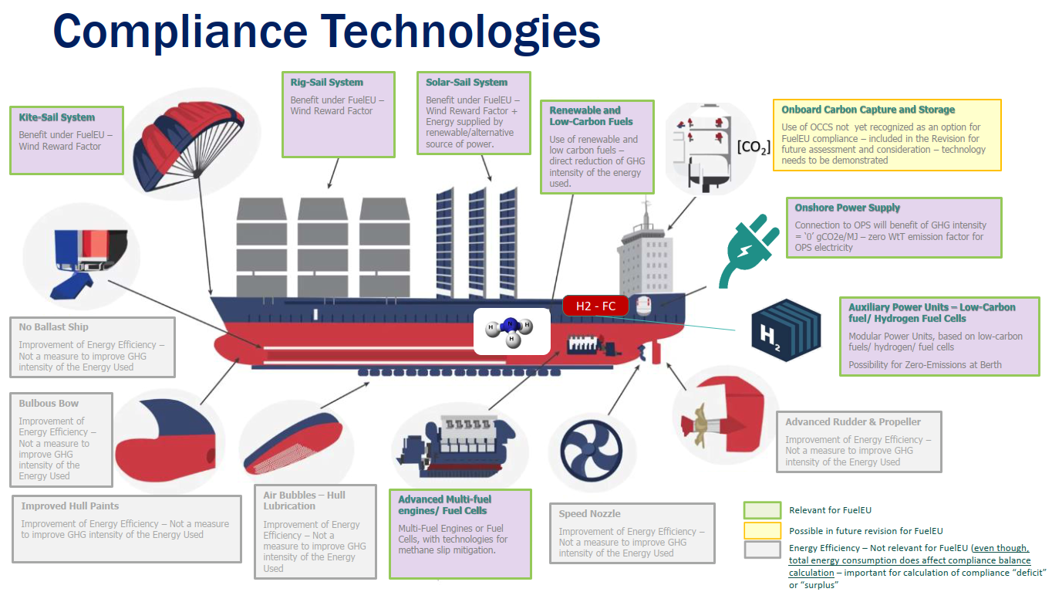

Slide 26
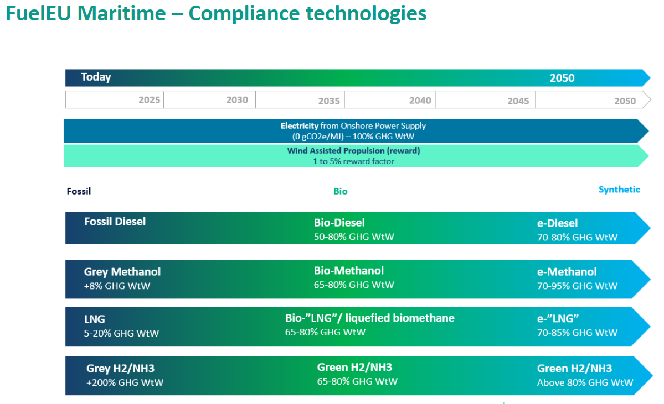

Slide 27

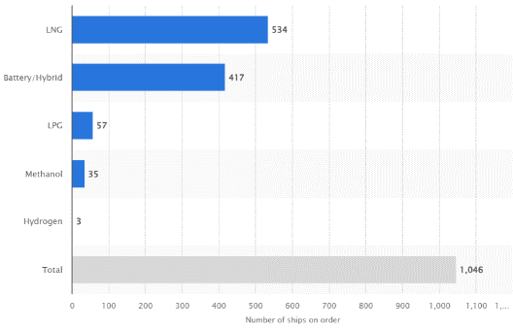

Number of ships in the global order book using alternative marine fuels (2022 data) by fuel type
Why this course?
Today 5.5% of fleet capacity is alternatively fuelled (was 2.3% in 2017), expected to reach 6.5% by 2025 (source Clarksons’ Green Technology Tracker https://www.clarksons.net).
The current orderbook has plenty of options, adopted on many ship types:
chemical tankers, bulk carriers, gas carriers, containerships, passenger ships, oil tankers, general cargo ships, dredgers, tugs, …
Solutions may be further upgraded, as alternative fuels become more available.
https://www.statista.com/statistics/1364297/ships-order-using-alternative-fuels-by-fuel-type-global/

Slide 28
Stepwise approach
SHIPS
FUEL
ENERGY CONVERTER
33 – offshore support vessels
4 - large cruise, large container ships
hydrogen
(CH2 or LH2)
e-ammonia
hybrid
Marine fuel cells,
(Internal Combustion Engines (ICE) in short run)
1 – small urban ferries
2 – feeders, ferries on short routes
e-ammonia
e-LNG
LH2
e-methanol
Marine fuel cells
(ICE in short run)
e-diesel
dual-fuel H2+diesel
dual-fuel ammonia+diesel
hybrid
Existing fleet (short term)
ICE

Slide 29
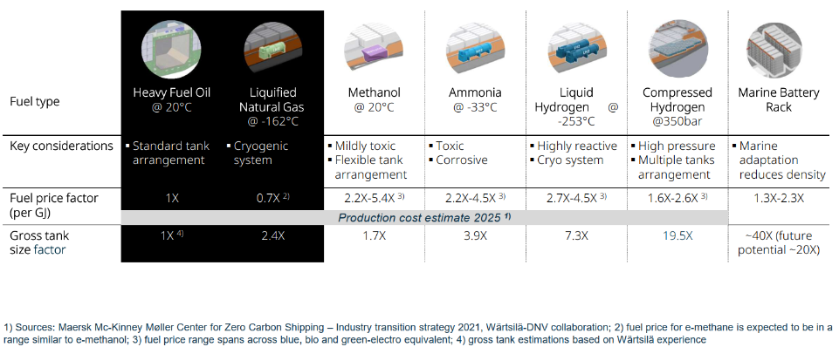
Alternative fuels

Slide 30
ENERGY EFFICIENCY (value for money)
maximum speed, ambient temperature, house lighting, ventilation, galley equipment, local entertainment, thermal insulation, k-factor of glazing, solar cells, pods, new materials, air conditioning, hull forms, antifouling, propellers, fixed/variable speed equipment, led lights, fan coils, friction coefficient, painting systems, fin stabilizers, side thrusters, trim wedges, hull appendages, video eq., hvac chillers, smart cards for cabin energy, propulsion motors, heat recovery, equipment cooling, air supply fans, fresh water generators, adsorption chillers, laundry equipment, heaters, amplifier racks, communication, theatre equipment, elevators, swimming pools, and many many more … … …

Slide 31
