Slide 1
ZHENIT E-learning programme #3 - Webinar
Tecnalia R&I
Joseba Urkiri

Slide 2
2. Main features of the ZHENIT Technologies
2.3. ORC-ejector integrated heat pump
2.2. Isobaric Expansion Engine (IEE)
2.1. Sorption desalination and cooling unit

Slide 3
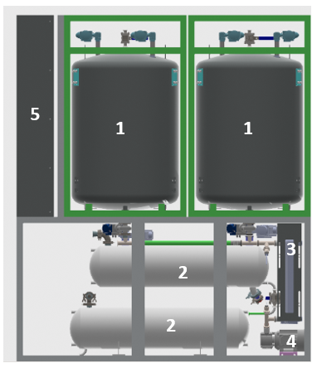
2.1. Sorption desalination and cooling unit
Prototype description
A unit that utilizes an adsorption/desorption cycle to produce fresh water from seawater or saltwater and generate cooling power simultaneously, leveraging the adsorption process.
This system employs a solid sorbent material and water as refrigerant and is notable for its ability to recover waste heat from engine cooling cycles.
Main components:
Two adsorption modules.
Four water tanks: two in vacuum (salted and fresh).
  two in ambient pressure.
Two plate heat exchangers.
Two pumps
Electical cabinet

Slide 4
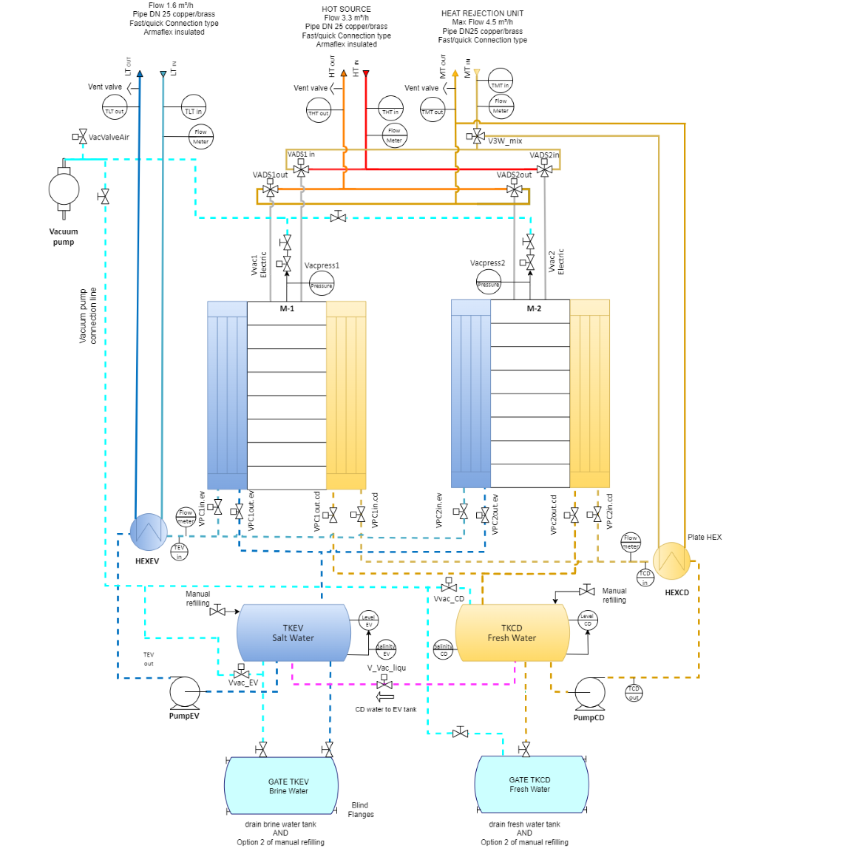
2.1. Sorption desalination and cooling unit
P&ID

Slide 5
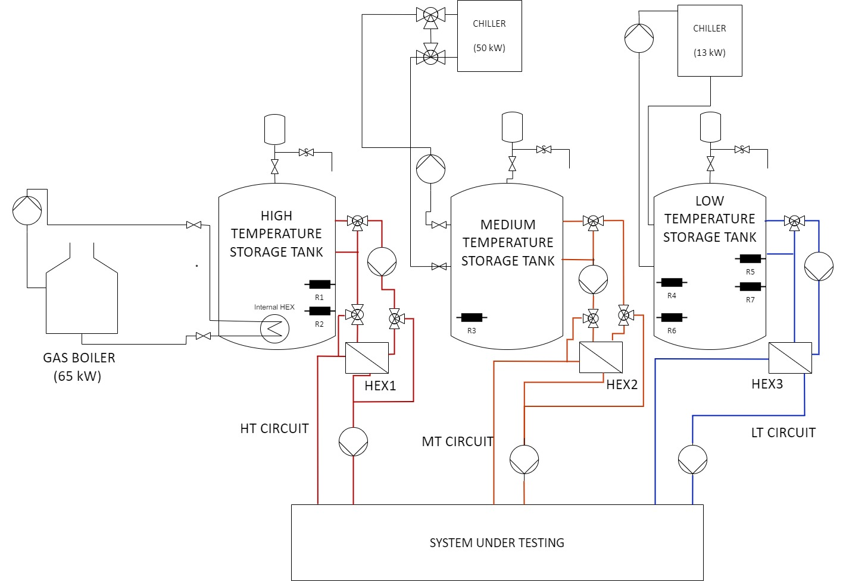
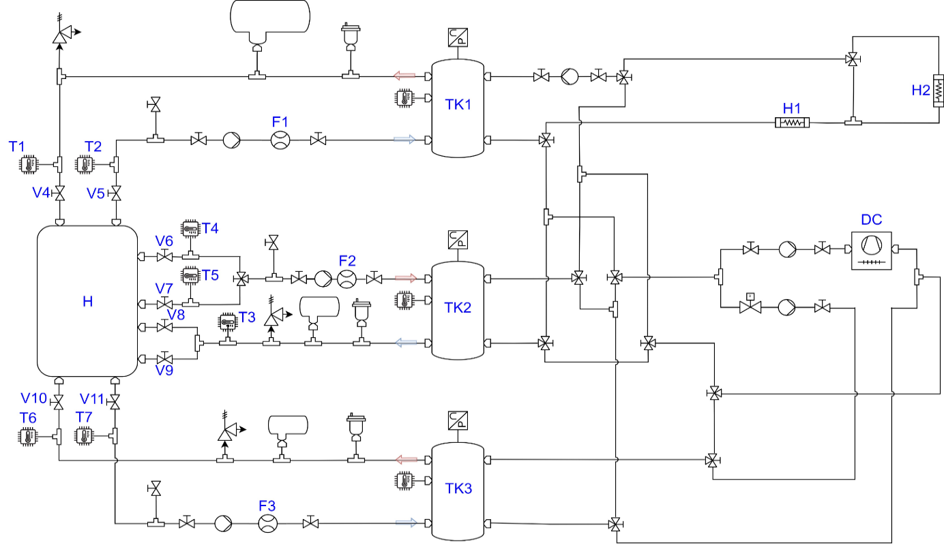
2.1. Sorption desalination and cooling unit
Experimental validation campaign
Pre-commissioning testing facilities at SOR
Validation testing facilities at CNR.

Slide 6
2.1. Sorption desalination and cooling unit
Testing matrix and results
Condition | T_MT 30°C | T_MT 35°C
T_HT 85°C T_LT 15°C Different flow rate Constant phase change duration | LT Flow 14l/min (Q_LT 4.80kW) LT Flow 20l/min (Q_LT 5.44kW) LT Flow 30l/min (Q_LT 5.45kW) | LT Flow 20l/min Q_LT 3.43kW
T_HT 85°C T_LT 15°C Constant Flow rate LT 20l/min Different phase change duration | Phase change duration 700sec (Q_LT 5.82kW) Phase change duration 500sec (Q_LT 6.23kW) Phase change duration 250sec (Q_LT 6.79kW) | LT Flow 20l/min , Phase change duration 500sec Q_LT 4.90kW
T_HT 75°C T_LTout 15°C | LT Flow 20l/min Phase change duration 250sec (Q_LT 5.75kW)

Slide 7
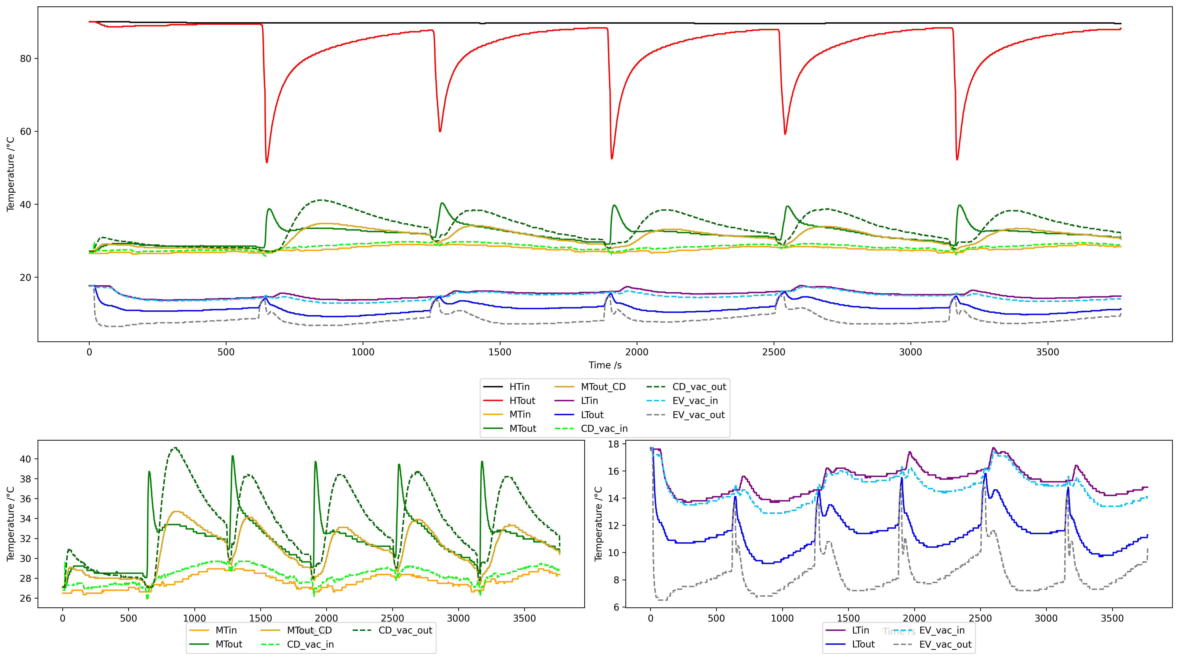
2.1. Sorption desalination and cooling unit
Ongoing experimental testing @ CNR ITAE

Slide 8
2.1. Sorption desalination and cooling unit
First results and future activities
Cooling power of aorund 6 kW with a COP of 0.3 obtained at nominal conditions (Tdes 90 °C Tcon 30 °C Teva 15 °C)
Cooling power can be increased up to 7 kW when the delta between condenser and evaporator reduces to 12 K, with a COP higher tan 0.4
Further testing at different driving temperatura will be carried out
Afterwards, desalination capacity will be checked under real operating conditions

Slide 9
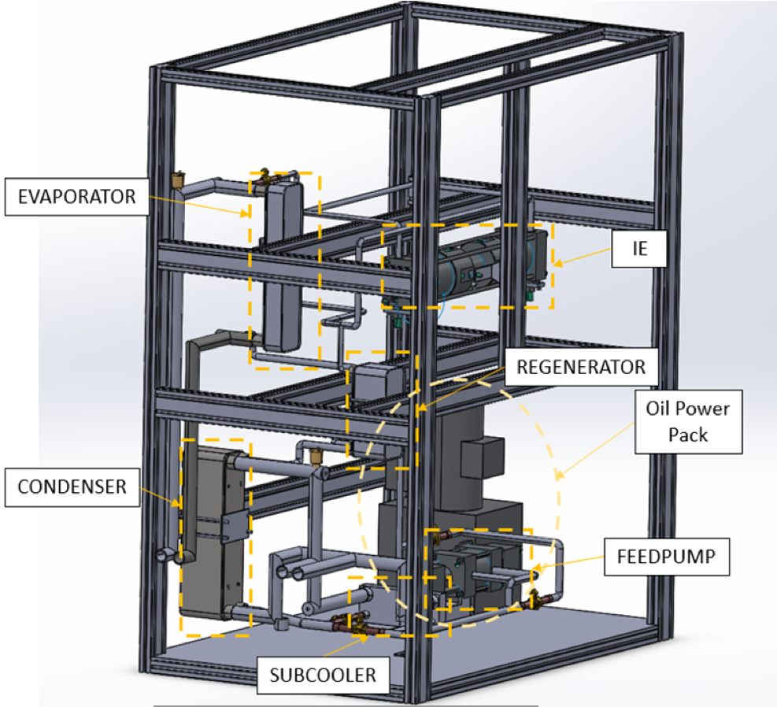
2.2. Isobaric Expansion Engine (IEE)
Prototype description
IEE is thermodynamical cycle that generates mechanical work by utilizing the temperature difference between a hot source (low grade waste heat) and a cold source, pumping a refrigerant through a closed circuit and harnessing the energy released through expansion.
Main components:
Four heat exchangers (Evaporator, Condenser, Subcooler and Regenerator)
Feedpump
Isobaric Expander
Oil Power Pack

Slide 10
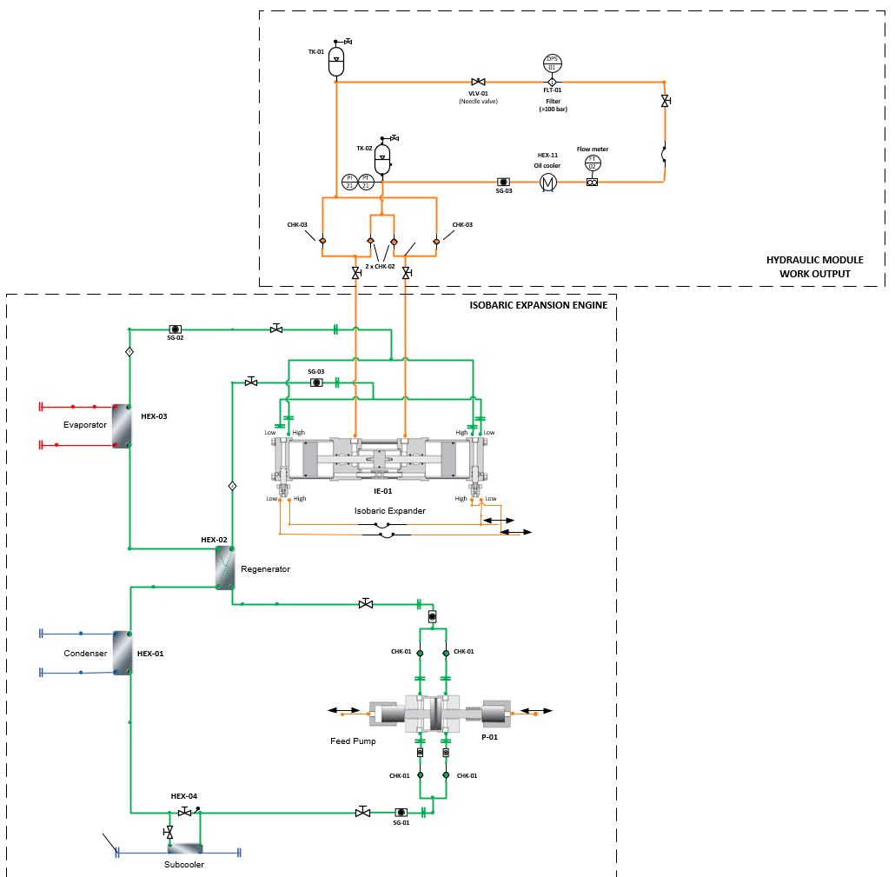
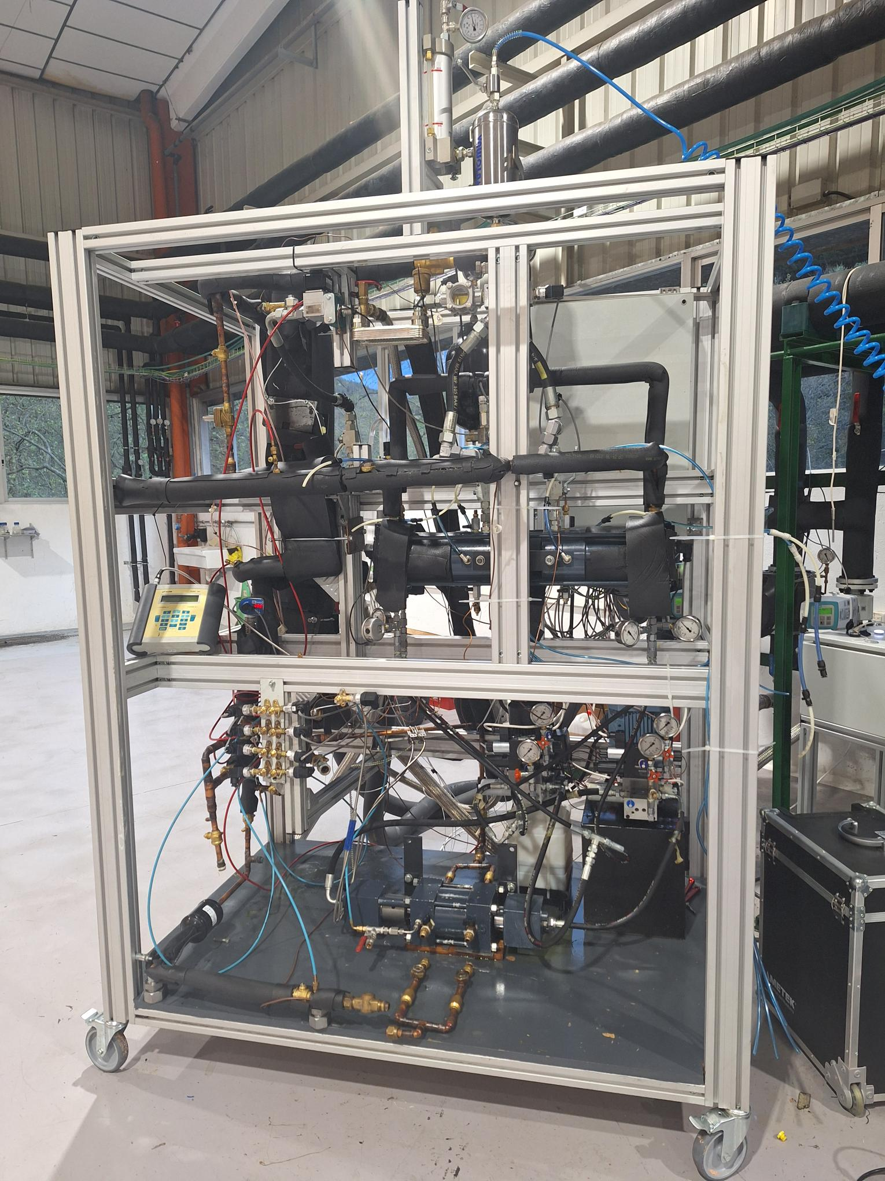
2.2. Isobaric Expansion Engine (IEE)
P&ID

Slide 11
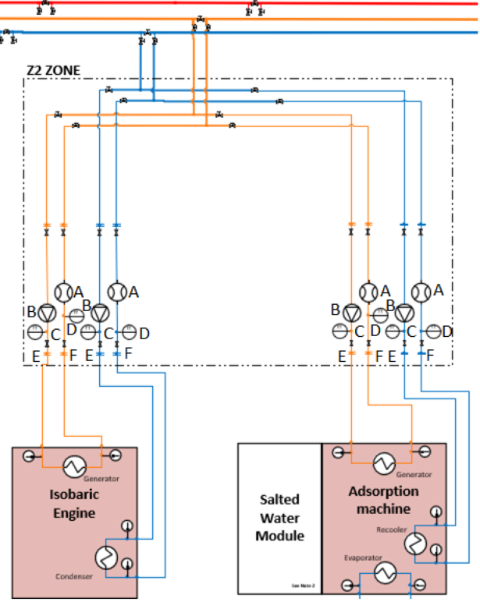
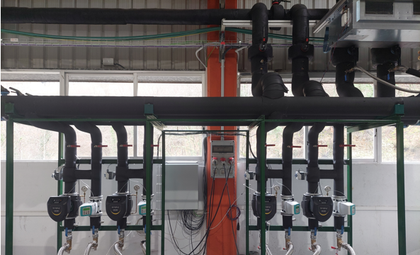
2.2. Isobaric Expansion Engine (IEE)
Facilities for testing
Thermal generation of the Azpeitia laboratory: 300 kWth (-10 to 150 °C)
Component | Number | Comments
Flexible hose | 8 | Flexible hoses of DN40 and 4m of length
Two-way valve | 8 | Manual two-way valves
Water pump | 4 | Circulation pump with variator (4,31 m3/h, 1,6MPa) , with electrical supply and control
Temperature transducer | 8 | PT100
Flow meter | 4 | Electromagnetic flow sensor DN40
Energy meter | 2 | For electrical consumption analysis of AM and IEE

Slide 12
2.2. Isobaric Expansion Engine (IEE)
Testing matrix
Test Condition | T_cond_water_in | T_evap_water_in | PowerPack_Power | Throttling valve
W20W80 | 20 °C | 80 °C | 30% | Min
 |  |  |  | -
 |  |  |  | Max
W20W90 | 20 °C | 90 °C | 30% | Min
 |  |  |  | -
 |  |  |  | Max
W30W80 | 30 °C | 80 °C | 30% | Min
 |  |  |  | -
 |  |  |  | Max
W30W90 | 30 °C | 90 °C | 30% | Min
 |  |  |  | -
 |  |  |  | Max
W40W80 | 40 °C | 80 °C | 30% | Min
 |  |  |  | -
 |  |  |  | Max
W40W90 | 40 °C | 90 °C | 30% | Min
 |  |  |  | -
 |  |  |  | Max

Slide 13
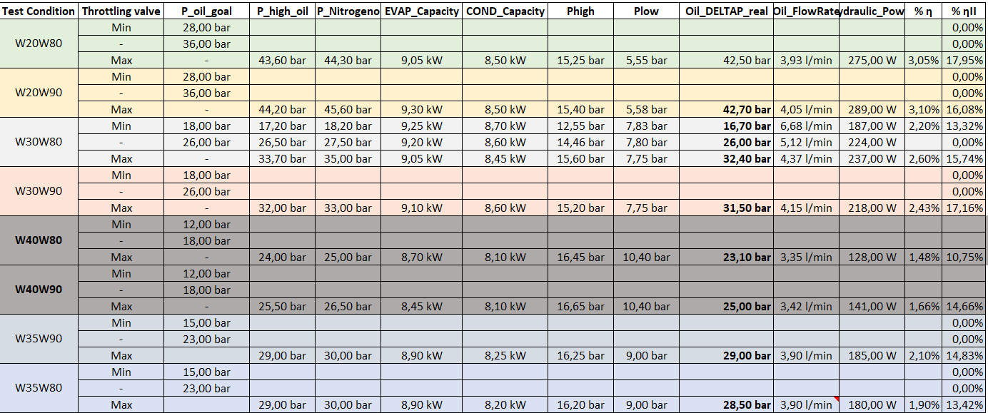
2.2. Isobaric Expansion Engine (IEE)
Test results

Slide 14
2.2. Isobaric Expansion Engine (IEE)
Conclusions and next steps
Hydraulic accumulator has a positive impact on flow stability, ensuring a more consistent performance. Be careful with the nitrogen charging pressure.
Greater temperature difference between heat sources results in increased power output and efficiency.
Increasing the throttling valve opening leads to a significant reduction in power output.
At higher suction pressures of the feed pump, the prototype starts to struggle, generating noise.
A variation in the cold source temperature causes a greater change in performance than a variation in the hot source temperature.
------------------------------------------------------------------------------------------------------------------------
Next steps: Evaluate and optimize feedpump frequencies to find the optimal operating point and maximize system performance.

Slide 15
2.3. ORC-Ejector integrated heat pump
Prototype description
This prototype uses waste heat to produce electricity, heat, and cooling, operating with waste heat input temperatures ranging from 50-60°C to 140°C.
The prototype is based on combinations of three main concepts:
Organic Rankine Cycle (ORC): Electricity generation and CHP
Ejector Cooling Cycle (ECC): Thermal activated cooling
Ejector Vapor Compression Cycle (EVCC): Thermal-Mechanical cooling
It has four operating modes:
Electricity generation only. (recuperative ORC)
Combined heat and power generation (non-recuperative ORC)
Combined electricity and cooling generation (ORC-EVCC)
Cooling only (VCC-ECC)
The prototype implements a hybrid EVCC under (serial and parallel ejector-compressor coupling)

Slide 16
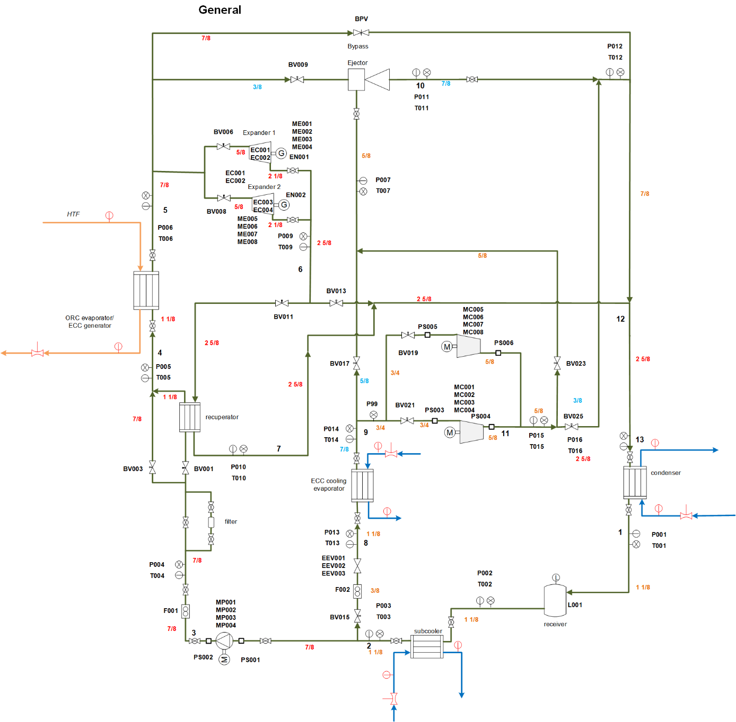
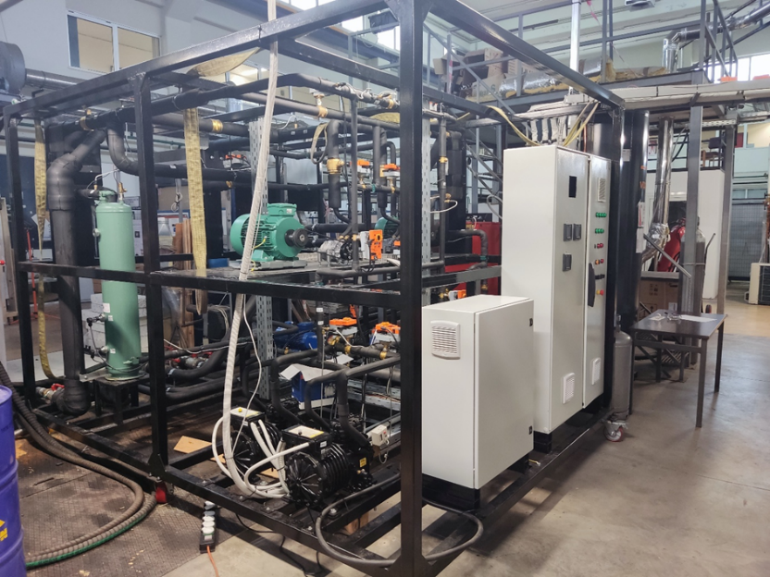
2.3. ORC-Ejector integrated heat pump
P&ID

Slide 17
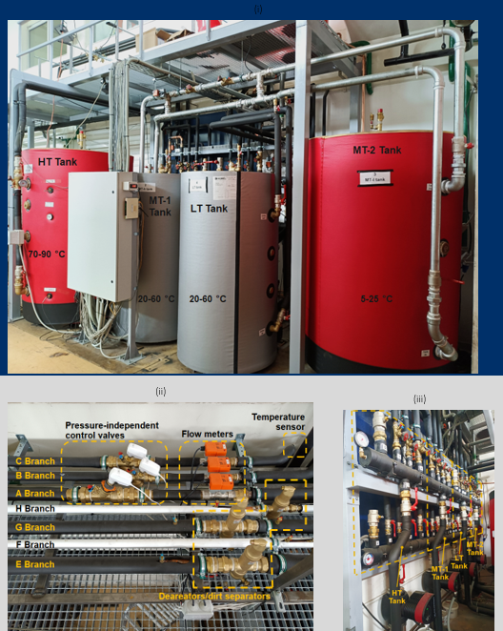
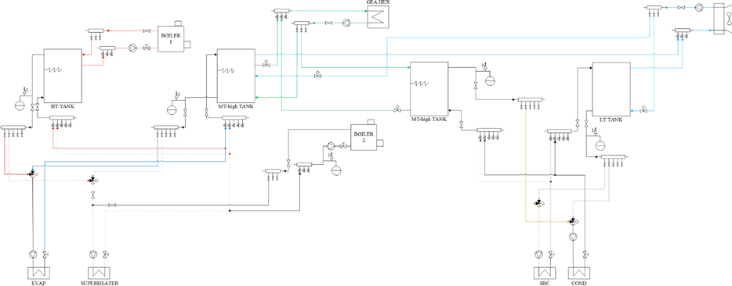
2.3. ORC-Ejector integrated heat pump
Experimental validation campaign
Hydraulic setup at NTUA, connected to the heat exchangers of the ORC ejector heat pump prototype.

Slide 18
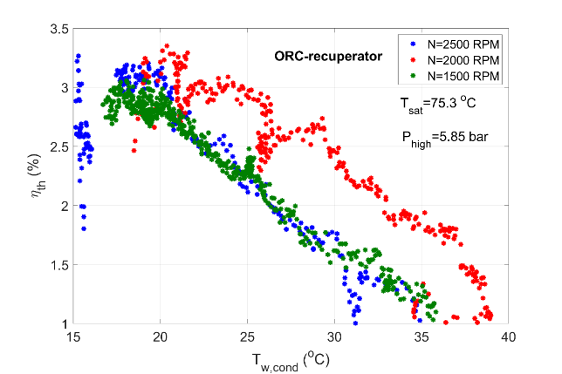
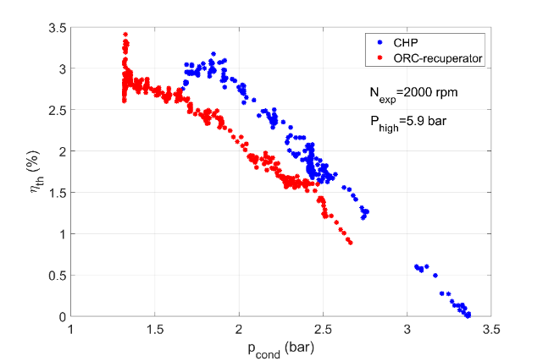
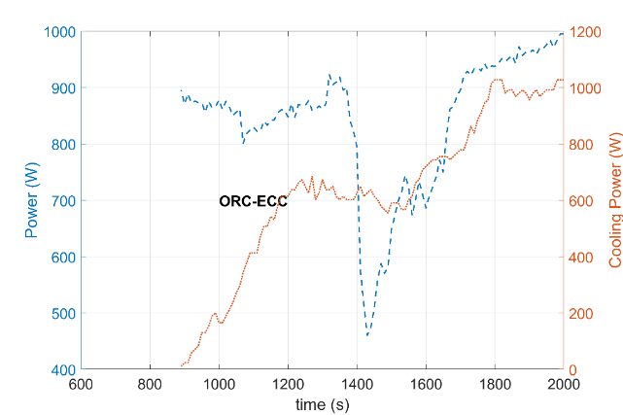
2.3. ORC-Ejector integrated heat pump
Prototype testing results
Variable | Range
Evaporator inlet temperature (°C) | 76.6-82.6
Evaporator water flow rate (l/s) | 1.0-1.6
Condenser inlet temperature (°C) | 18.6-51.1
Condenser water flow rate (l/s) | 0.22-1.5
Subcooler inlet temperature (°C) | 14.0-23.0
Subcooler flow rate (l/s) | 0.15
Expander speed (rpm) | 800-2650
Pump speed (rpm) | 100-365
Expander/Ejector inlet pressure | 3.7-6.2 bar
Condensation pressure | 1.14-3.80 bar
Cooling Evaporator inlet temperature (°C) | 8.0-14.0
Cooling Evaporator water flow rate (l/s) | 1.0-1.2
Cooling Evaporator Pressure | 0.48-0.81
Compressors speed (rpm) | 1000-1500

Slide 19
2.3. ORC-Ejector integrated heat pump
Results and conclusions
Successful demonstration of ORC for both operating modes (electricity and CHP)
Globally the first instance of successful experimental demonstration of the parallel ORC-ECC concept for combined cooling and power production.
First demonstration of EVCC concept for electricity-heat driven cooling

Slide 20
Thank you for your attention!
Tecnalia R&I
Joseba Urkiri

