Slide 1
ZHENIT E-learning programme #3 - Webinar
NTUA
Assist. Prof. Konstantinos Braimakis

Slide 2
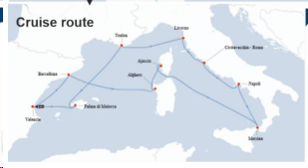
Development of dynamic modelling platform for evaluation and optimization of ZHENIT technologies onboard

Slide 3
Summary of scope of ZHENIT solutions included in the platform
Technology | Waste heat temperature range (indicative) | Useful outputs
Isobaric Expansion Engine (IEE) | Low-T (60-90℃) | Mechanical power for fuel injection
Sorption-desalination chiller (SDC) | Low-T (70-90℃) | Desalinated water, cooling
ORC-Ejector integrated heat pump (ORCEIHP) | High-T (120-140℃) | Electricity, heating, cooling
Latent Thermal Energy Storage (LTES) | Low-T and High-T | Passive system, can be used for driving active ZHENIT technologies or for providing space heating/hot water (the latter only at lower temperatures)

Slide 4
Architecture of modelling platform
Generic layout of ZHENIT technologies
ZHENIT technologies utilized WH at two temperature levels at higher (>100℃) and lower (<100℃) temperature
ORCEIHP: high temperatures, up to 140 ℃
SDC and IEE operate at much lower temperatures below 90℃.
ORCEIHP oriented to high-T WH originating from engine exhaust gases (EG) and SDC and IEE to low-T WH originating from the jacket cooling water (JCW)

Slide 5
Conceptual design of ZHENIT technologies used as basis for dynamic modelling platform

Slide 6
Conceptual design of ZHENIT technologies used as basis for dynamic modelling platform

Slide 7
Generic WHR layout WHR- hex-buffer tank-LTES-active ZHENIT technology

Slide 8
Sizing methodology
Heat duty (kW_{th}) | 1000 | 250
Hot fluid | exhaust gases | jacket cooling water
Hot fluid mass flow rate (kg/s) | 25 | 7
Hot fluid inlet temperature (℃) | 250 | 85
Hot fluid outlet temperature (℃) | 150 | 75
Cold fluid | heat transfer oil | water
Cold fluid mass flow rate (kg/s) | 10 | 6
Cold fluid inlet temperature (℃) | 140 | 70
Cold fluid outlet temperature (℃) | 190 | 80
Overall heat transfer coefficient (W/m2K) | 250 | 1500
Definition of WHR hex

Slide 9
Sizing methodology
Definition of design and sizing of ZHENIT technologies
Parameter | ORC | IEE./SDC
Heat source | heat transfer oil | water
Nominal heat input (kW_{th}) | 1000 | 250
Minimum technology operating temperature (℃) | 140 | 65
Maximum technology operating temperature (℃) | 190 | 80
$${\dot{Q}}_{technology,heat,input,nom}=f_{technology}{\dot{Q}}_{WHR−hex,nom}$$
$f_{technology}$: factor for scaling active ZHENIT technologies

Slide 10
Sizing methodology
Definition of buffer tank
Parameter | High-T tank | Low-T tank
Fluid | heat transfer oil | water
Minimum tank top temperature (℃) | 50 | 50
Maximum tank top temperature (℃) | 220 | 100
$f_{buffer,tank}$: factor for sizing buffer tank
$$E_{buffer,tank}=f_{buffer,tank}3600{\dot{Q}}_{WHR−hex,nom}$$
$$M_{buffer,tank}=\frac{E_{buffer,tank}}{{cp}_{buffer,tank}\left(T_{buffer,tank,max}−T_{technology,min}\right)}$$
$$V_{buffer,tank}=\frac{M_{buffer,tank}}{ρ_{buffer,tank}}=Η_{buffer,tank}π\frac{{d_{buffer,tank}}^{2}}{4}=π\frac{{d_{buffer,tank}}^{3}}{2}$$

Slide 11
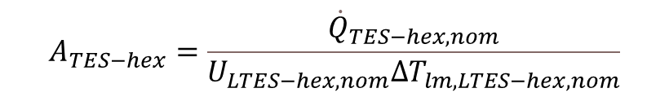


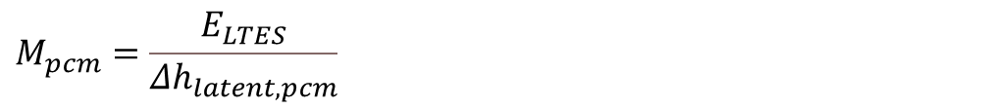
Sizing methodology
Definition of LTES
Definition of LTES hex
Parameter | High-T LTES | Low-T LTES
Material | H190 | A78
Melting temperature (℃) | 191 | 78
Latent heat of melting (kJ/kgK) | 170 | 225
Minimum SoC (%) | 5% | 5%
Maximum SoC | 95% | 95%
$${\dot{Q}}_{LTES−hex,nom}=f_{LTES,hex}{\dot{Q}}_{WHR−hex,nom}$$
$f_{LTES,hex}$: factor for sizing LTES hex
$$A_{TES−hex}=\frac{{\dot{Q}}_{TES−hex,nom}}{U_{LTES−hex,nom}{ΔT}_{lm,LTES−hex,nom}}$$
$f_{LTES}$: factor for sizing LTES
$$E_{LTES}=f_{LTES}3600{\dot{Q}}_{WHR−hex,nom}$$
$$M_{pcm}=\frac{E_{LTES}}{{Δh}_{latent,pcm}}$$

Slide 12
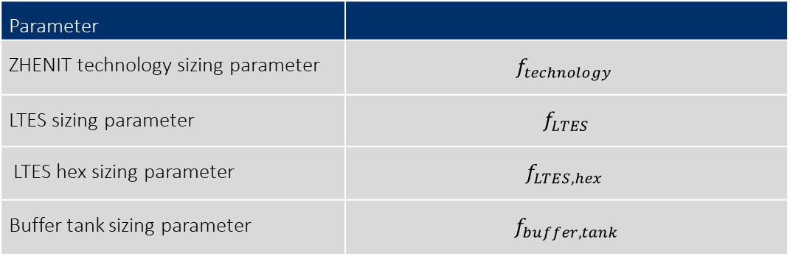
Sizing optimization
Parameter
ZHENIT technology sizing parameter | $$f_{technology}$$
LTES sizing parameter | $$f_{LTES}$$
LTES hex sizing parameter | $$f_{LTES,hex}$$
Buffer tank sizing parameter | $$f_{buffer,tank}$$

Slide 13
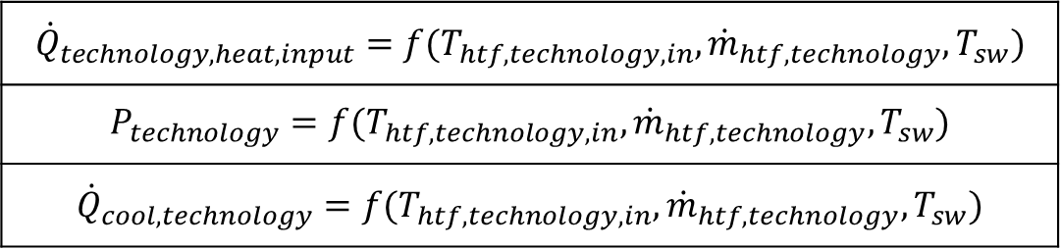
Dynamic modelling methodology and operating modes
WHR hex
Active ZHENIT technologies performance maps derived from detailed part-load models
$${\dot{Q}}_{WHR−hex}=ε_{WHR−hex}{\dot{Q}}_{WHR−hex,max}$$
LTES hex
$${\dot{Q}}_{technology,heat,input}=f(T_{htf,technology,in},{\dot{m}}_{htf,technology}, T_{sw})$$
$$P_{technology}=f(T_{htf,technology,in},{\dot{m}}_{htf,technology}, T_{sw})$$
$${\dot{Q}}_{cool,technology}=f(T_{htf,technology,in},{\dot{m}}_{htf,technology}, T_{sw})$$
$${\dot{Q}}_{LTES−hex}=ε_{LTES−hex}{\dot{Q}}_{LTES−hex,max}$$
LTES
$$E_{LTES,stored,i+1}=E_{LTES,stored,i}±\left|{\dot{Q}}_{LTES−hex}\right|Δt$$

Slide 14
Dynamic modelling methodology and operating modes
Notes:
WHR hex (waste heat recovery heat exchanger): In the WHR hex, heat is recovered from the WH stream (EG or JCW) and transferred to the HTF (thermal oil or water).
Circulating pump P1: P1 is a constant speed circulating pump. It can be switched on or off depending on the operating mode of the system. If P1 is switched on, it supplies a specific HTF flow rate from the buffer tank to the WHR hex. If P2 is switched off, no HTF is supplied to the WHR hex.
Buffer tank: This is a buffer tank filled with HTF. The buffer tank is filled with HTF. Its purpose is to act as a thermal buffer between the hot HTF circuit connected to the WHR hex and the cold HTF circuit that is connected with the LTES and active ZHENIT technology.
Circulating pump P2: P2 is a constant speed circulating pump. It can be switched on or off depending on the operating mode of the system. Generally, valve P2 operates at constant speed, extracting a specific HTF flow rate If from the cold side of the buffer tank. If P2 is switched off, not HTF is extracted from the buffer tank.
LTES/LTES hex: The LTES system includes an LTES hex. It function as the thermal energy storage component of the overall system. The heat exchanger that is inside the LTES (LTES hex) is used for transferring heat between the PCM and the HTF that is send to the LTES.
Regulating valve V1: Valve V1 is a regulating valve. Its role is to determine the amount of HTF that is sent to the active ZHENIT technology or the LTES.
Two-way valve V2: Valve V2 is a two-way valve. It either sends all HTF coming from the LTES to be mixed with HTF and be supplied to the ZHENIT technology, or it sends all HTF coming from the LTES to be mixed with HTF leaving the ZHENIT technology.
Generally, each active ZHENIT technology has an operational temperature range, from a minimum to a maximum temperature ($T_{technology,min}$, $T_{technology,max}$). Based on the relationship of the buffer tank top temperature and these two temperatures, the operating mode of the system is determined.
WHR modes
If, at any timestep, the temperature of the tank top is below a threshold ($T_{buffer,tank,top}$ $<T_{buffer,tank,max}$), HTF is supplied from the buffer tank to the WHR hex to recover heat. In this case, P1 is switched on. If, at any timestep, the temperature of the tank top exceeds the threshold ($T_{buffer,tank,top}$ $>T_{buffer,tank,max}$), no HTF is supplied from the buffer tank to the WHR hex, thus P1 is switched off. This happens independent of what happens on the low-temperature section of the HTF circuit.
Production mode
If the HTF temperature in the tank top is between the operating temperatures of the ZHENIT technology ($T_{technology,min}≤T_{buffer,tank,top}$ $≤T_{technology,max}$), the HTF is directly supplied to the ZHENIT technology and the LTES is bypassed. Therefore, valve V1 sends all HTF directly to the ZHENIT technology.
Charging modes
If the buffer tank top temperature is higher than the maximum operating temperature of the ZHENIT technology ($T_{buffer,tank,top}>T_{technology,max}$), the LTES is charged if its SoC is below a maximum threshold (${SOC}_{LTES}<{SOC}_{LTES,max}$). In this case, valve V1 diverts all HTF to the LTES HEX. In this case there are two possibilities that are described next.
Charging mode 1: Charging and production mode
If, after charging the LTES, the temperature of the HTF at the outlet of the LTES hex is lower than the maximum operating temperature of the ZHENIT technology ($T_{htf,LTES−hex,out}≤T_{technology,max}$), the HTF is diverted from V2 to the ZHENIT technology.
Charging mode 2: Exclusive charging mode
If, after charging, the temperature of the HTF at the outlet of the LTES hex is higher than the maximum operating temperature of the ZHENIT technology ($T_{htf,LTES−hex,out}>T_{technology,max}$), V2 diverts all HTF back to the buffer tank, thus the ZHENIT technology is completely bypassed.
Discharging modes
If the HTF temperature in the buffer tank is lower than the minimum operating temperature of the ZHENIT technology ($T_{buffer,tank,top}<T_{technology,min}$), then the following possibilities are available:
Discharging mode 1: Discharging and production
If the SoC of the LTES is sufficiently high (${SOC}_{LTES}>{SOC}_{LTES,min}$), valve V1 diverts part of the flow to the LTES HEX so that the temperature of the HTF after mixing is equal to the minimum operating range of the technology plus sum tolerance to enable operation of the ZHENIT technology (discharging mode). Basically this is ensured by a condition of the following type: ($T_{htf,mix1,out}≥T_{technology,min}+{ΔT}_{technology,tol}$).
This is achieved with a controller that aims to find the V1 opening (basically the HTF mass flow rate sent to the LTES) to attain the desired temperature after mixing. If a feasible mass flow rate is obtained by the controller, then V2 diverts all HTF coming from the LTES to ΜΙΧ.
Discharging mode 2: Discharging - no production
If it is not possible for the controller of V1 to calculate a feasible HTF mass flow rate enabling a sufficiently high temperature for the ZHENIT technology, then all HTF flow rate is sent to the LTES and the ZHENIT technology is bypassed. In this case V2 sents the HTF coming from the LTES hex to the buffer tank.

Slide 15
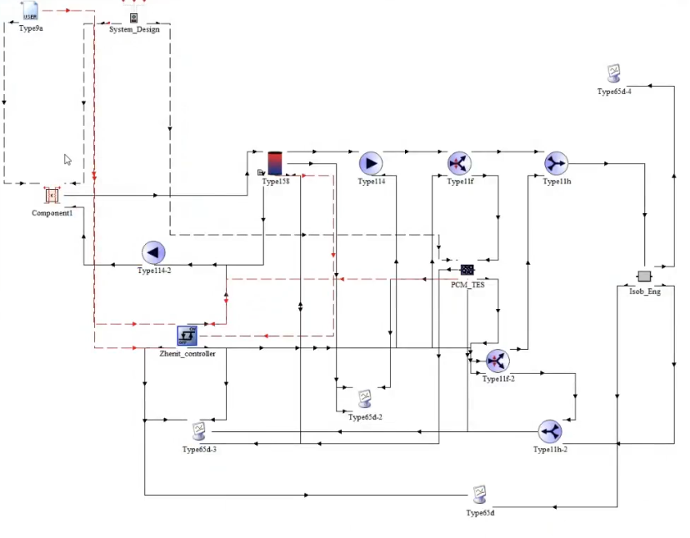
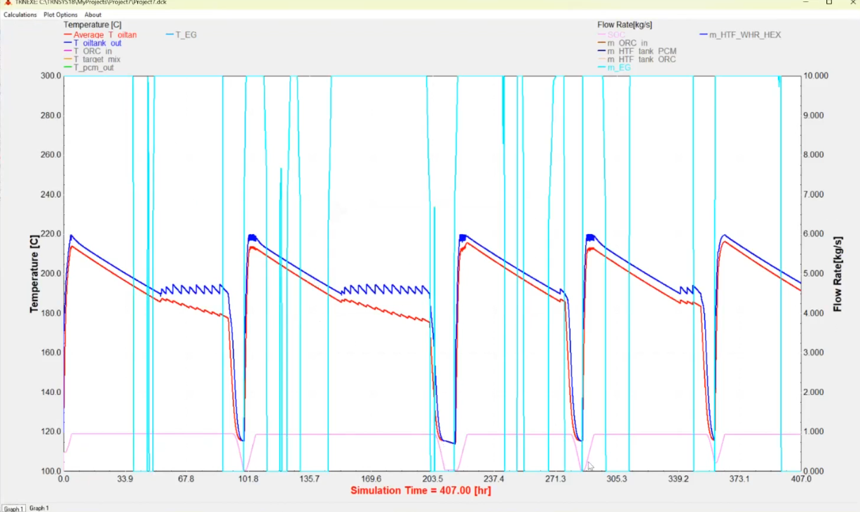
WHR-ORC model developed in TRNSYS

Slide 16
Thank you for your attention!

