Slide 1
ZHENIT E-learning programme #3 - Webinar
CNR
Dr. Andrea Frazzica

Slide 2
Index
1) Survey of existing technologies for WHR on board
2) Main features of ZHENIT technologies
3) Modelling aspects

Slide 3
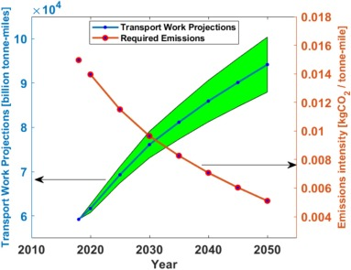
Background information:
Roughly 3% of total GHG emissions are currently due to vessels above 100 tons¹.
The international trade are expanding while the IMO is targeting a reduction of GHG by 50% withing 2050^{2,3}.
Among the different approaches to improve shipping efficiency, waste heat recovery (WHR) can allow maximizing the energy contained in fuel (currently only 50% of it converted in mechanical energy).
¹ P. Balcombe, et al. How to decarbonise international shipping: Options for fuels, technologies and policies, 2019
²IMO et al., “Third IMO Greenhouse Gas Study 2014,” International Maritime Organization (IMO), p. 327, 2014, doi: 10.1007/s10584-013-0912-3.
³U. Nations, “Take urgent action to combat climate change and its impacts,” sdgs.un.org. 2022

Slide 4
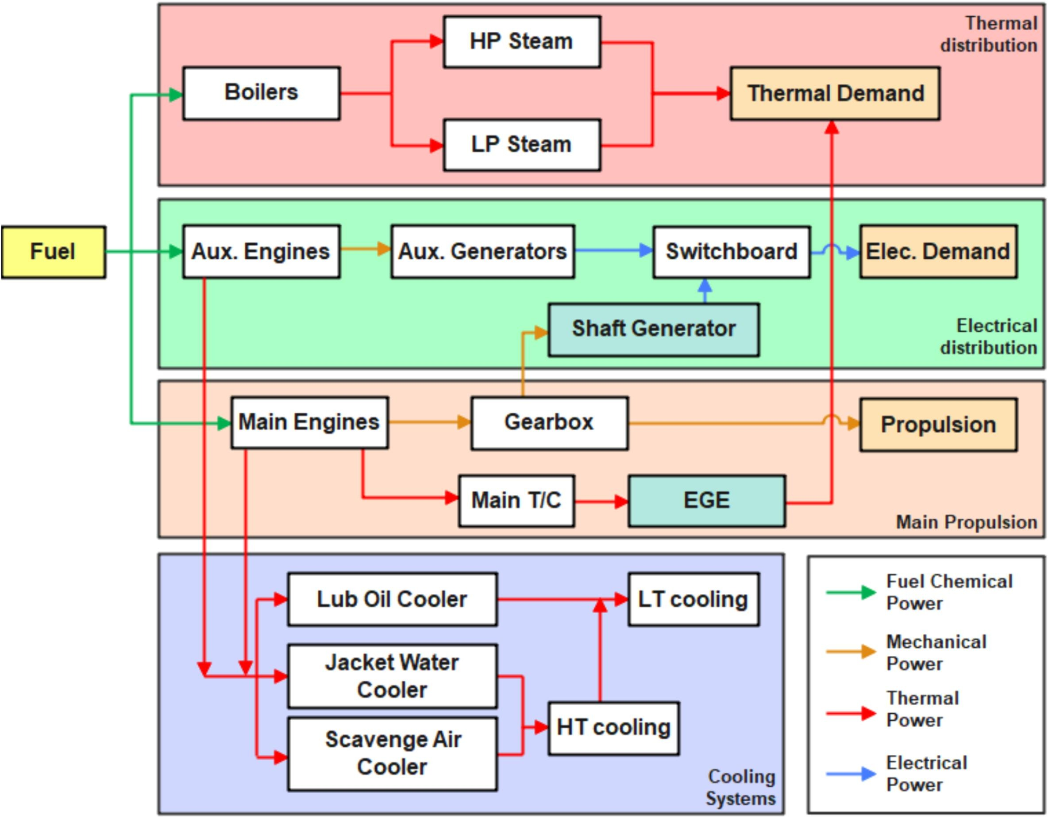
On-board energy system⁴:
⁴ R.Fisher et al. Innovative waste heat valorisation technologies for zero-carbon ships − A review. 2024

Slide 5
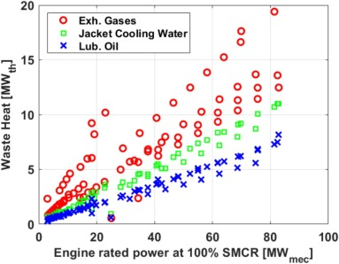
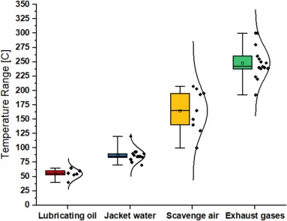
Waste heat potential on board⁴:
Potential to harvest up to 40% of WH
Different temperature levels of WH
⁴ R.Fisher et al. Innovative waste heat valorisation technologies for zero-carbon ships − A review. 2024

Slide 6
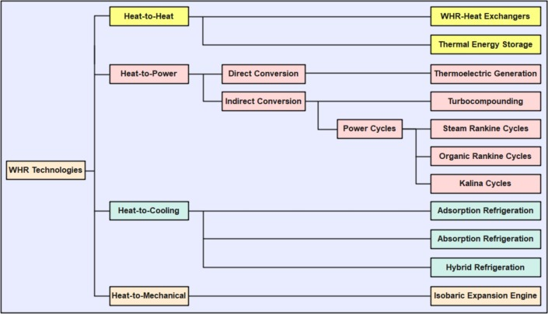
Classification of WHR technologies⁴:
⁴ R.Fisher et al. Innovative waste heat valorisation technologies for zero-carbon ships − A review. 2024

Slide 7
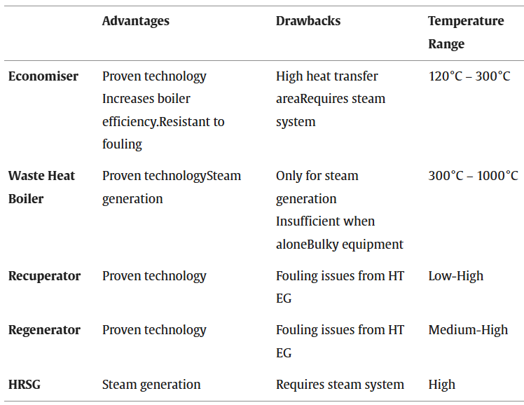
Heat-to-Heat technologies⁴:
⁴ R.Fisher et al. Innovative waste heat valorisation technologies for zero-carbon ships − A review. 2024

Slide 8
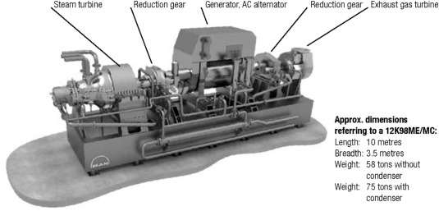
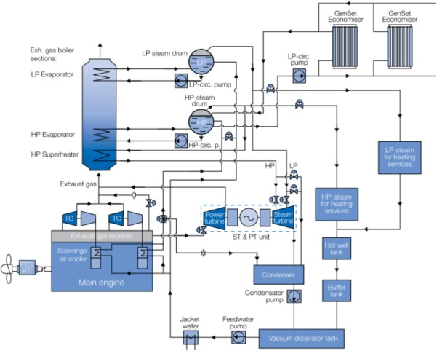
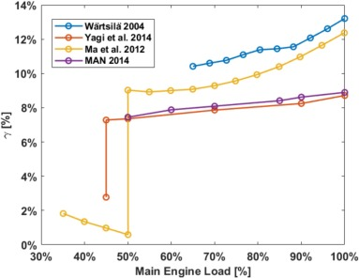
Heat-to-power technologies – Combined steam and power turbine:
⁵M. A. N. D. & Turbo, “Waste Heat Recovery System (WHRS),” 2014.

Slide 9
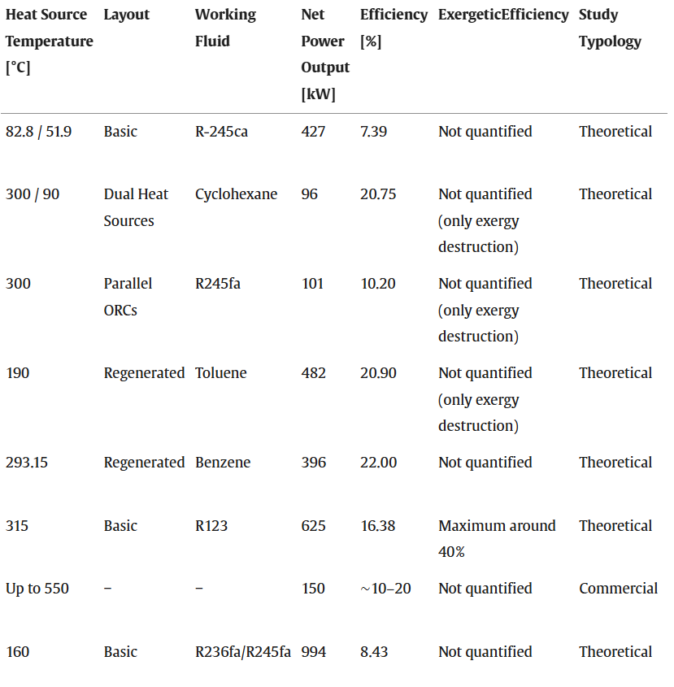
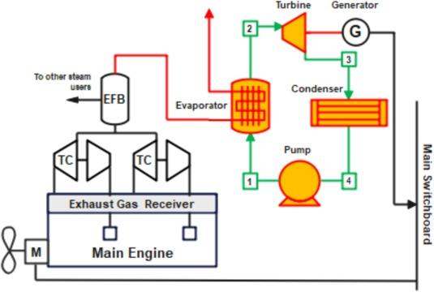
Heat-to-power technologies – Organic Rankine Cycles⁴:
⁴ R.Fisher et al. Innovative waste heat valorisation technologies for zero-carbon ships − A review. 2024

Slide 10
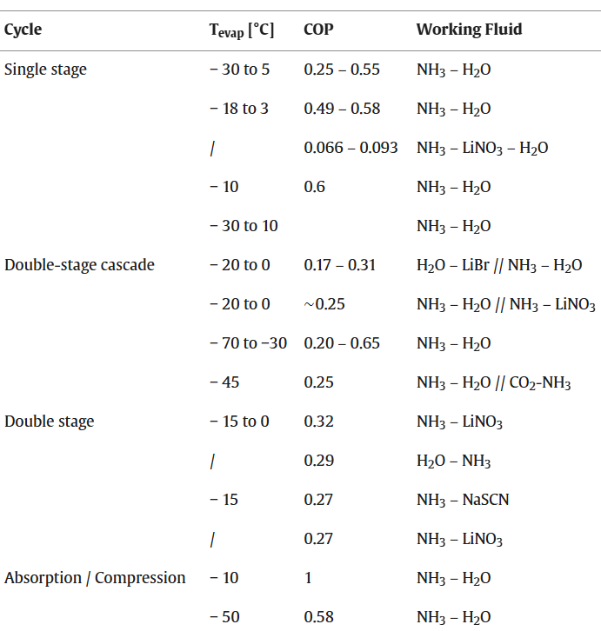
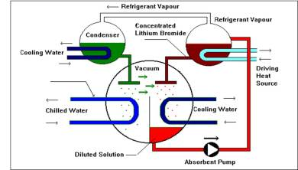
Heat-to-cooling technologies – Absorption :
⁶ https://www.thermaxglobal.com/

Slide 11
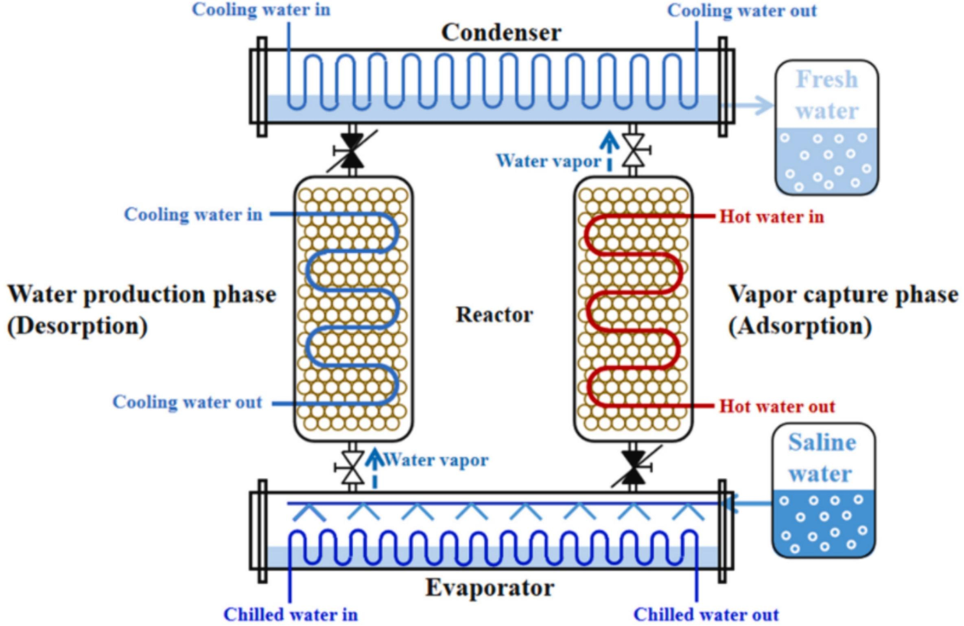
Heat-to-cooling technologies – Adsorption :
⁷ Y. Zhang, V. Palomba, A. Frazzica
Understanding the effect of materials, design criteria and operational parameters on the adsorption desalination performance – A review. 2022

Slide 12
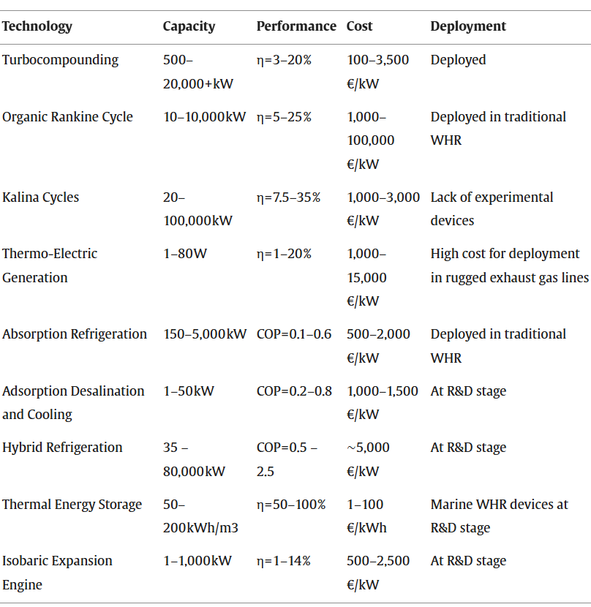
WHR technologies – overall comparison:
⁴ R.Fisher et al. Innovative waste heat valorisation technologies for zero-carbon ships − A review. 2024

Slide 13
Thank you for your attention!

