Slide 1

1st Workshop “Navigating Towards Zero-Emission Shipping: The IMO Decarbonization Goals and ZHENIT Project” – October 18th 2024
S. Roosjen – Encontech B.V.

Slide 2

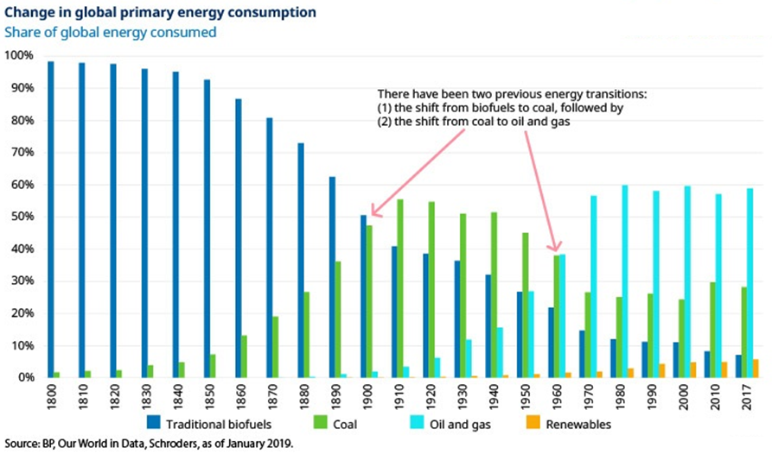
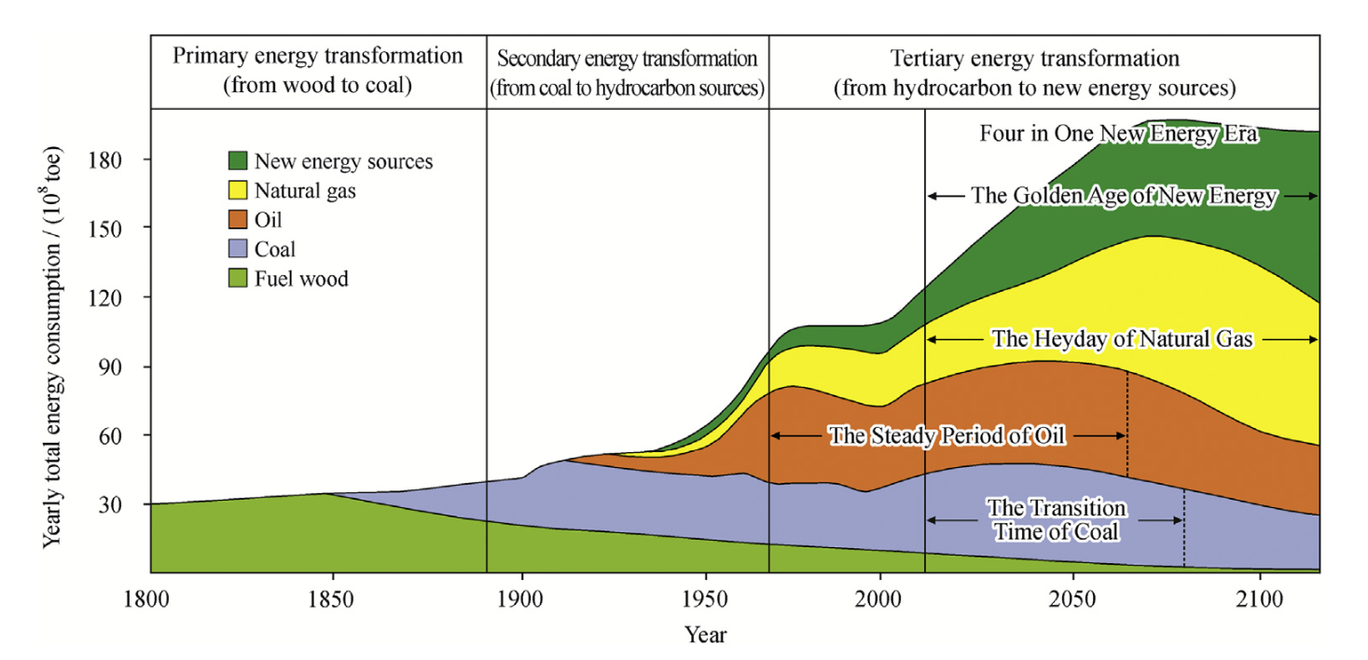
Introduction to the Marine Energy Transition
The global energy system is vast and essential to modern life, but heavily reliant on fossil fuels.
The transition aims to reduce CO2 emissions and achieve sustainability goals by 2050.
Aligning with Zhenit’s focus, the transition requires innovative technologies and sustainable practices.
History and outlook

Slide 3
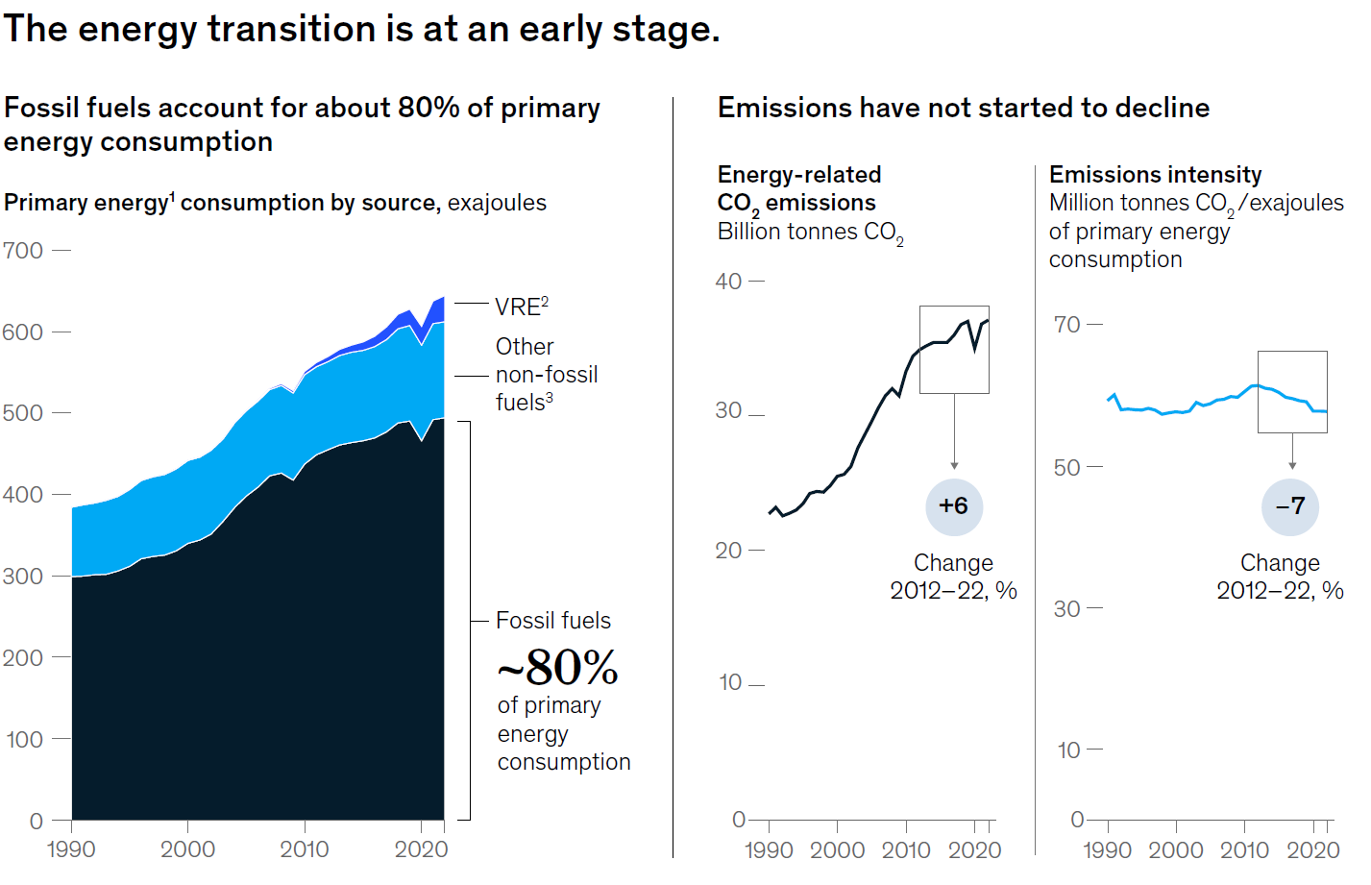
Marine Innovation and Technology for the Energy Transition
Technological innovations in offshore wind farms, wave energy converters, and tidal turbines are crucial for harnessing marine energy.
Advances in green marine transportation technologies, such as electric and alternative-powered ships, are essential for reducing maritime emissions.
Zhenit promotes tech-driven marine solutions for a sustainable and low-carbon future.

Slide 4
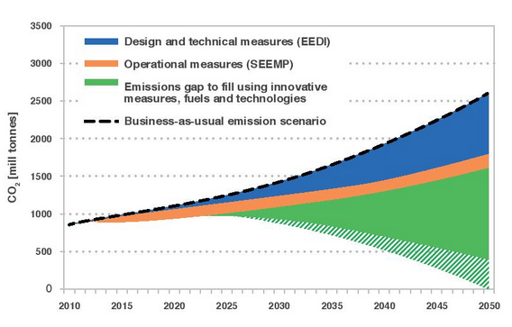
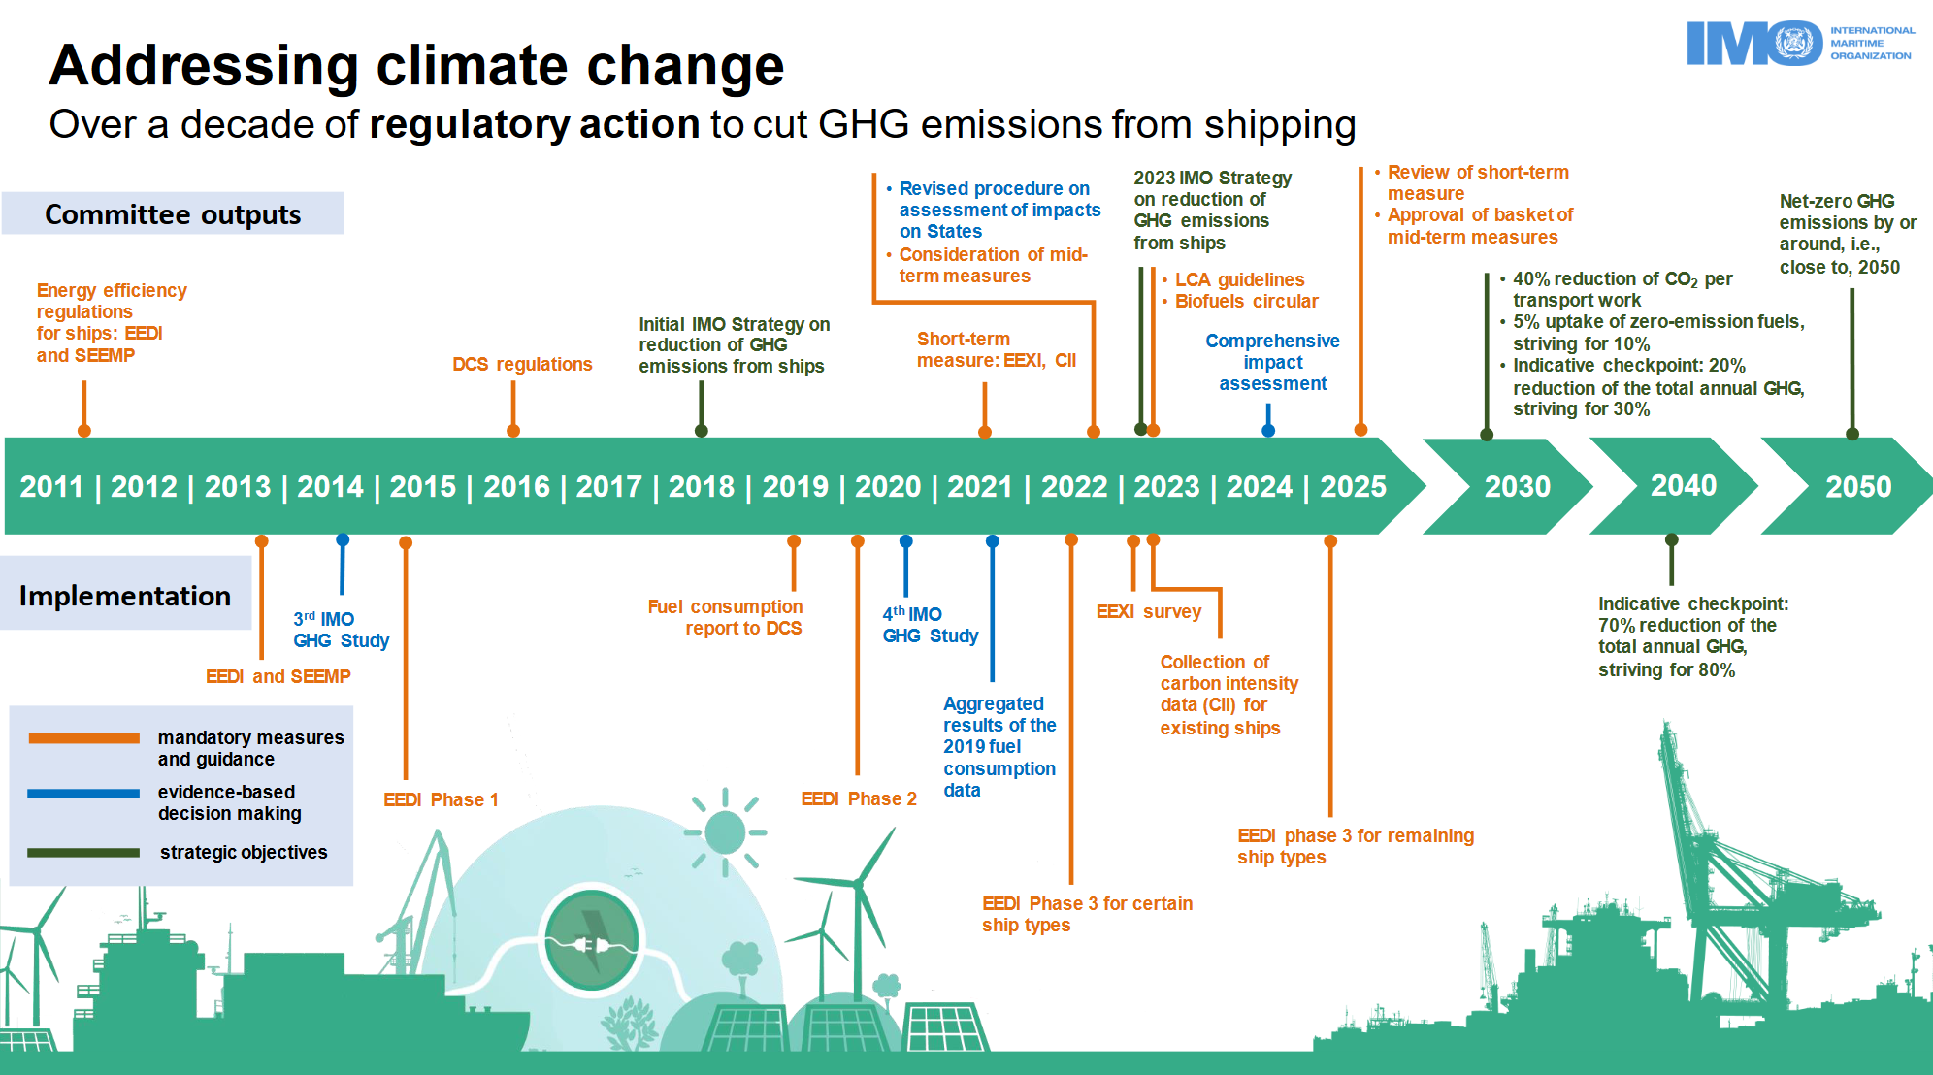
Strategic Roadmap for a Sustainable Marine Transition
The International Maritime Organization (IMO) aims for net-zero greenhouse gas (GHG) emissions in international shipping by 2050. Key targets include reducing carbon intensity by 40% by 2030 and achieving at least 70% emissions reduction by 2040. The strategy also promotes the use of zero or near-zero GHG fuels, targeting a 5-10% uptake by 2030. This comprehensive strategy involves technical and economic measures, with mid-term measures planned for adoption in 2025 and implementation by 2027.

Slide 5
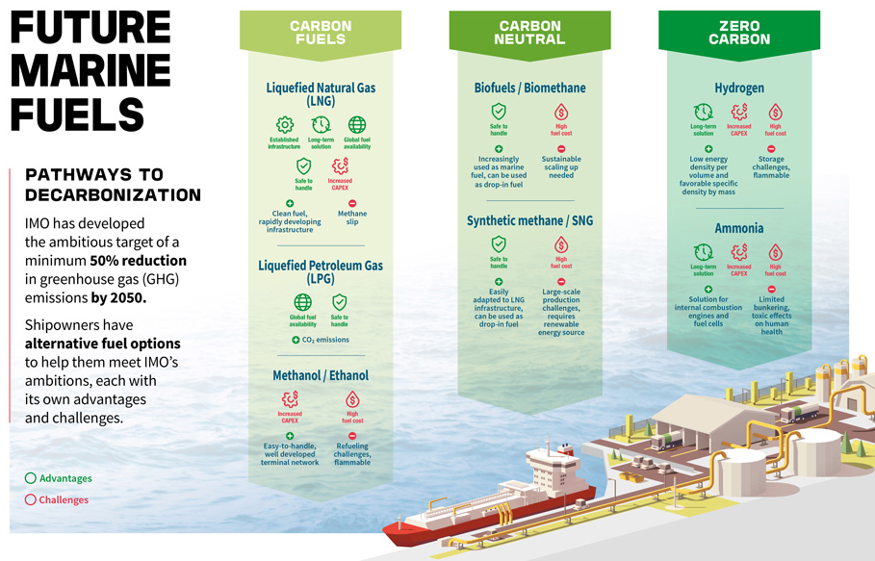
Addressing Marine Physical Challenges through Sustainability
The marine sector faces unique challenges, including harsh ocean conditions, marine biodiversity impact, and the need for robust infrastructure.
Sustainable practices, such as environmentally friendly marine construction and operations, are essential.
Zhenit’s approach aligns with developing innovative, sustainable solutions to meet these marine-specific challenges.

Slide 6
Innovative Marine Solutions to Key Challenges
Alternative Fuels
  Green Hydrogen
  Ammonia
  Biofuels
  Methanol
Energy Efficiency
  Wind-Assisted Propulsion
  Air Lubrication
  Hull / Prop design
  Waste Heat Recovery
Carbon Capture
  Onboard Carbon Capture Storage
Digitalisation / Smart Shipping
  Autonomous sailing
  Fleet / Route optimalisation
  Just-in-Time Shipping
5. Port Decarbonization
  Shore Power (cold ironing)
  Green port infrastructure
  Automated port logistics
6. Circular Economy for Shipping
  Sustainable Ship Materials
  Modular Ship Design
7. Fuel Cells
  SOFC – Fuel agnostic
  Energy dense storage technologies
8. Nuclear power
  Small Modular Reactors (SMR)
9. Incentive Mechanisms & Policy Innovations
  Carbon Pricing and ETC
  Green financing & subsidies
These solutions, while promising, require global cooperation, substantial investment, and supportive policies to drive marine decarbonization at scale. Collaboration between governments, private companies, and research institutions will be crucial in ensuring a smooth and sustainable transition to a zero-carbon maritime future.

Slide 7
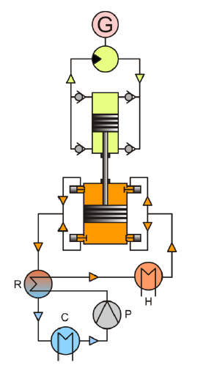
Waste Heat Recovery
ENCONTECH WASTE HEAT RECOVERY
No competition in the range < 120°C. Completely unique technology.
Isobaric Expansion Technology
With over 20 years of R&D in the field of external combustion and heat engines we can now demonstrate an economically viable and robust machine to valorize ultra low grade heat < 100 °C with a minimum temperature difference of 20°C.
Isobaric expansion technology presents the solution for recovering and utilizing low-grade heat in mini- to medium-scale applications. It is very versatile, easily scalable and reproducible in all industries.

Slide 8
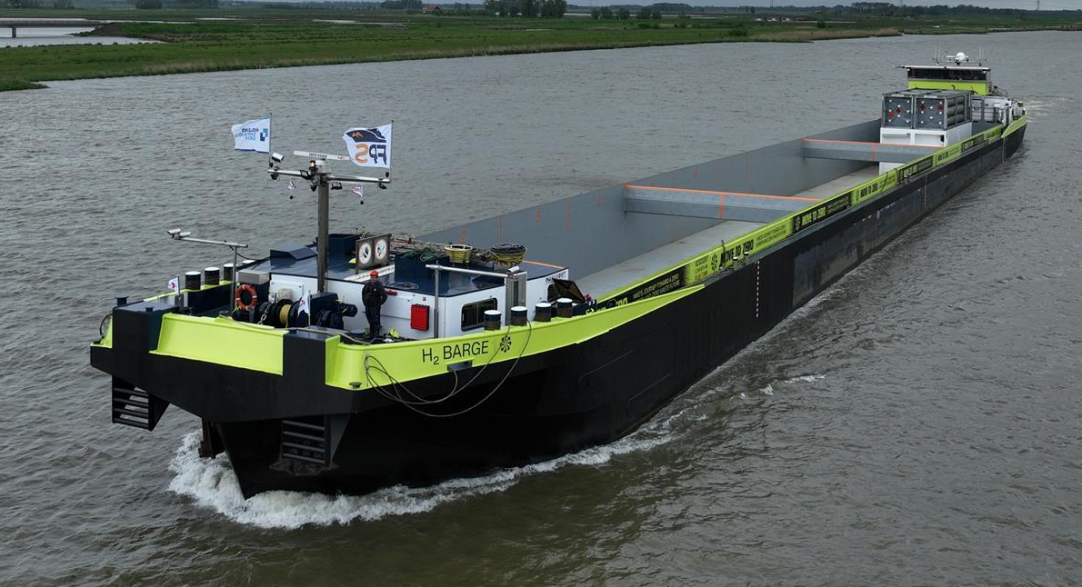
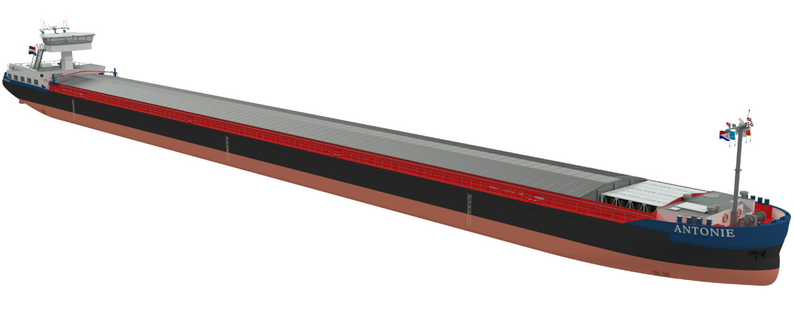
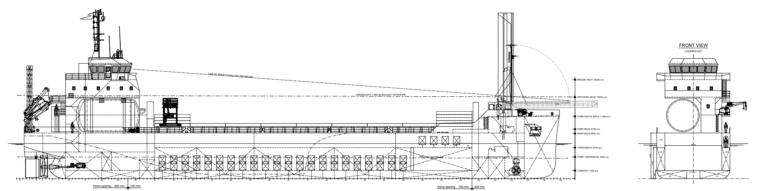
Examples
Hydrogen Barge 1 & 2
MS Antonie
Concept Coaster 200m³ LH₂

Slide 9
Conclusion
There is no single "silver bullet" for achieving marine decarbonization; a combination of technologies and strategies is essential.
The IMO's strategy focuses on gradual targets toward net-zero emissions by 2050.
Key goals include reducing carbon intensity by 40% by 2030 and reaching at least 70% reduction by 2040.
Adoption of zero or low-carbon fuels, improved energy efficiency, and policy measures will be critical to success.
Collaboration across the shipping industry, governments, and technology developers is crucial for hitting these targets.

Slide 10
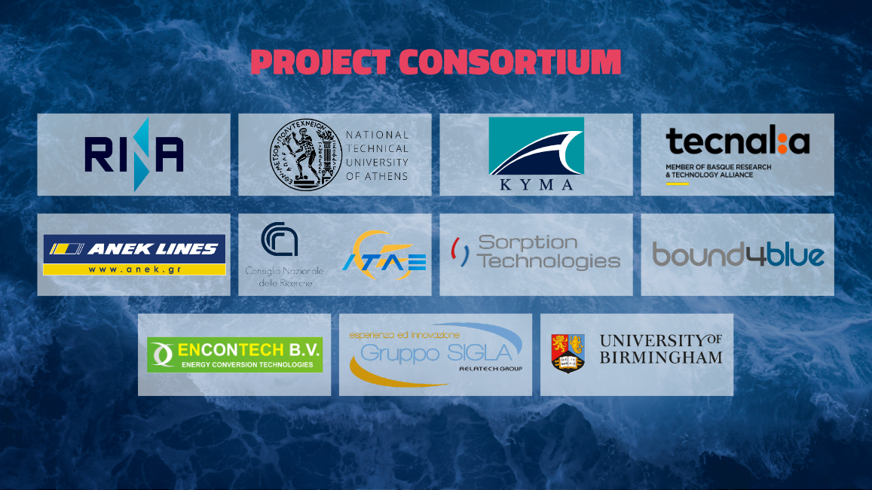

Slide 11
