Slide 1

1st Workshop “Navigating Towards Zero-Emission Shipping: The IMO Decarbonization Goals and ZHENIT Project” – October 18th 2024
Francesca Di Gruttola – RINA Consulting

Slide 2

ZHENIT: General Information
  Acronym: Zero waste Heat vessel towards relevant ENergy savings also thanks to IT technologies
  Call: HORIZON-CL5-2021-D5-01-10
  Topic: Clean and competitive solutions for all transport modes
  Innovative on-board energy saving solutions
  Research and Innovation Action (RIA) – 100% Funding
  Starting date: 1 June 2022
  Duration: 42 months (3.5 years)
  Ending: 30 November 2025
  Current Month: M29 October 2024 (more than 60%)
  Budget: 4,384,488.75 €
  HORIZON-CL5-2021-D5-01-10 financed projects:
  HEMOS
  OPTIWISE
  RESHIP
  Sister projects:
  ENGIMMONIA

Slide 3

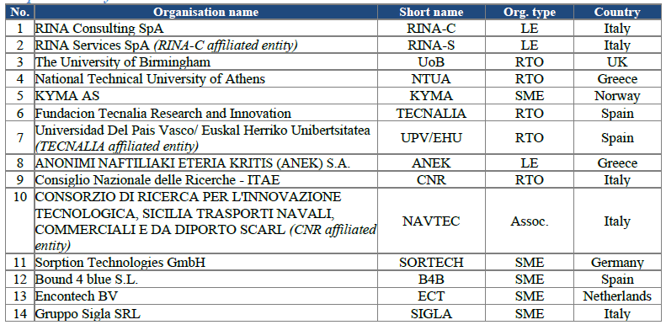





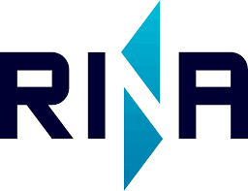




The Consortium

Slide 4




ZHENIT Mission
ZHENIT aims to reduce up to 25% the overall ship primary energy need, fully unlocking on-board waste heat recovery (WHR) potential developing and validating solutions both in the lab and on-board (TRL5) to valorise WH at different temperatures/from different sources and for different end-product (WH-to-X) properly coupled with alternative propulsion systems (wingsail), ICT monitoring/energy management solutions and thermal energy storages.
Innovative WH-to-X technologies
ICT monitoring/
energy management
Hybrid Propulsion systems (wingsail)
Thermal energy storage

Slide 5



ZHENIT Drivers, Challenges and Responses
Reduction of Vessel Emissions, Particularly in Hoteling/Harbour Operations
Stricter regulations targeting urban pollution and reducing fossil fuel dependence.
Enhancement of waste heat recovery (WHR) and energy management on board, delivering clean energy solutions and low-emission ship services.
Limited Advancement of Traditional WHR in Shipping
Challenges related to size optimization, cost reduction, and acceptance within the naval regulatory framework.
Development of new WHR technologies, on-board validation, and an in-depth analysis of regulatory frameworks.
Holistic integration and management of various "ready-to-go" WH-to-X systems, energy management, and hybrid propulsion technologies
Unlocking the Full Potential of Onboard WHR
Maximizing the use of waste heat recovery on vessels

Slide 6








ZHENIT Technologies
HYBRID PROPULSION (WINGSAIL)
Thermal Energy Storage (TES)
for optimal WHR
Isobaric Expansion (IE) engine WH-to-mechanical work
T<100°C
T>100°C
Innovative ORC integrated with HP with ejector
WH-to-Trigeneration
70<T<100°C
Adsorption system
WH-to-cooling and desalination
On-Board Advanced Monitoring
Integrated Control for WHR maximization
Thermal energy storage
Hibrid propulsion systems
Digital solution
3 WH-to-X technologies coupled with

Slide 7


ZHENIT Validation
Validation campaign at two different levels:
1 | TECNALIA Thermal Energy Systems LAB
Possibility to operate with working water T° between -10ºC and 150ºC It embeds a multi-purpose climatic chamber with controlled environment WH-to-X solutions are already present in the lab | Develop design and test of prototype and validate the integration and compatibility of these solution in LAB and on-board (From TRL3 to TRL4)
2 | Demo vessel
To be installed on board: Waste-to-Cooling/Desalination Adsorption Chiller, Monitoring system and Controller | Develop design and test of prototype and validate the integration and compatibility of these solution in LAB and on-board (From TRL3 to TRL4)

Slide 8
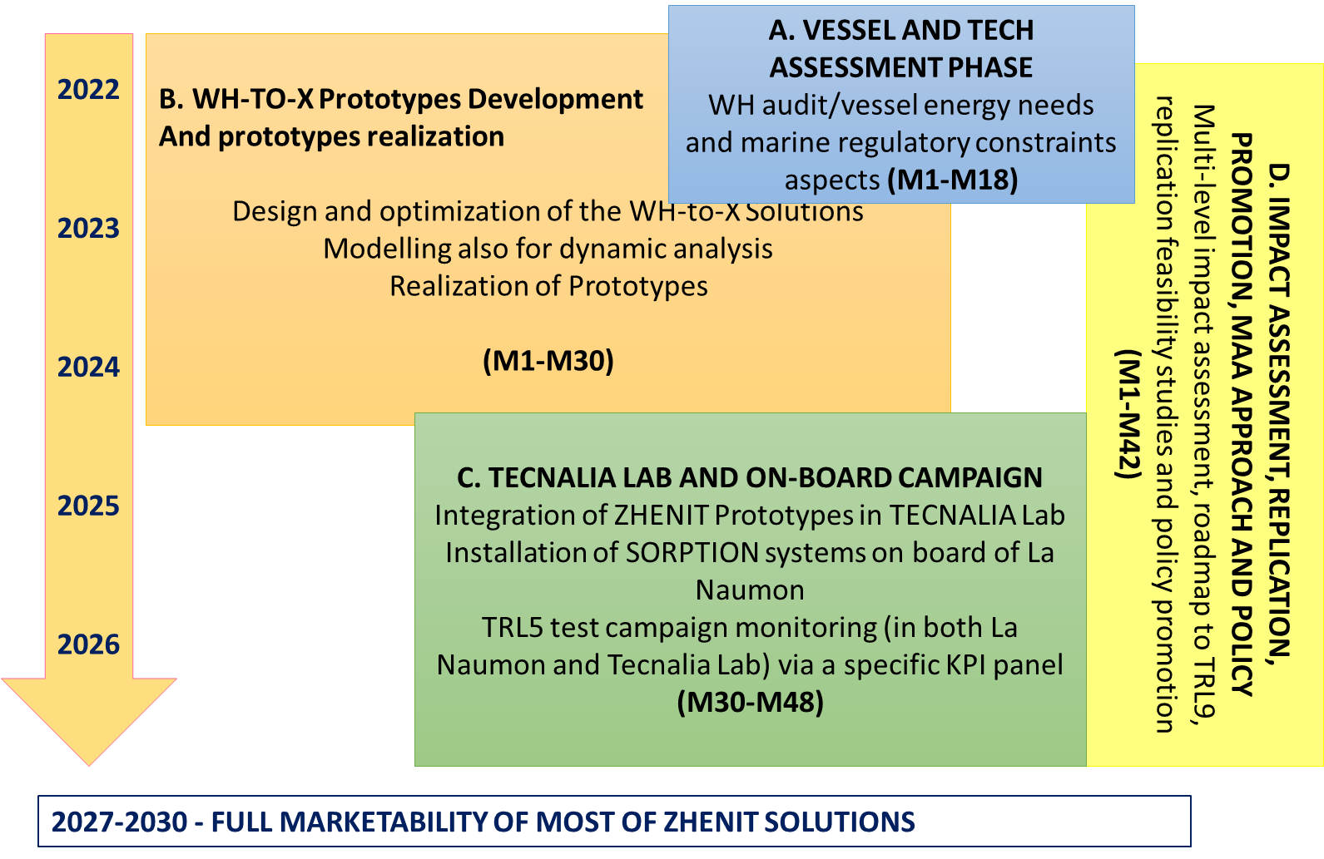
ZHENIT Methodology
on-
board

Slide 9
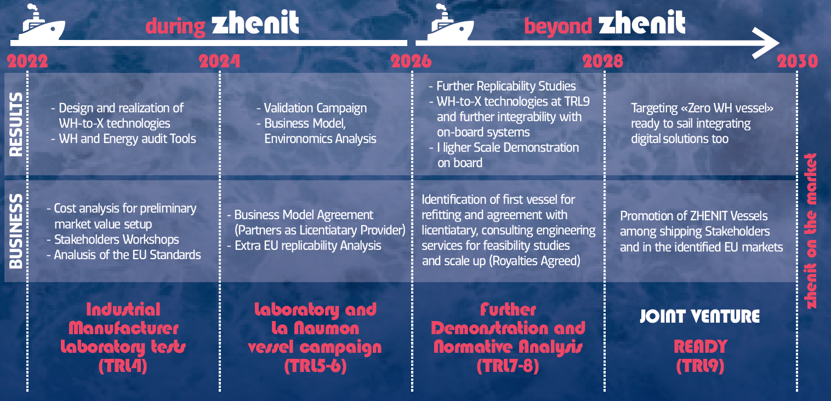
ZHENIT Roadmap

Slide 10
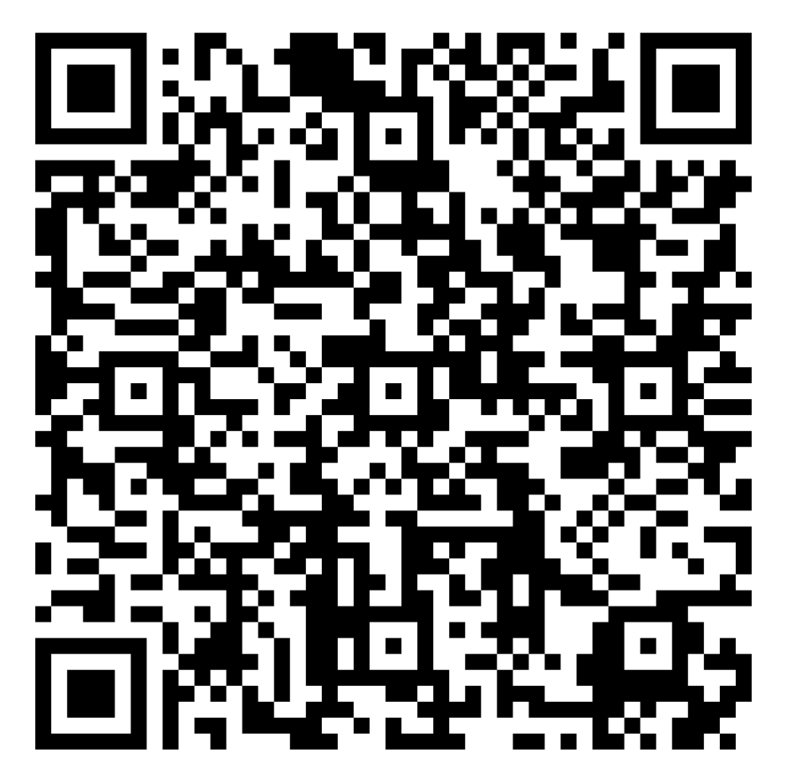
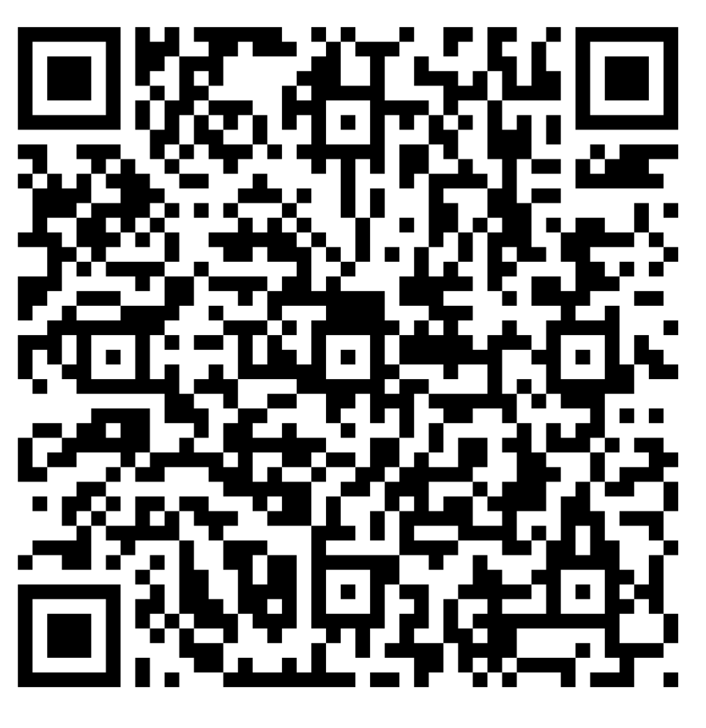
ZHENIT Surveys
Stakeholders’ Feedback Survey
Social Acceptance Survey

Slide 11
